Slide 1

DRAG AND LIFT COMPARISON BETWEEN A HIGH-END AND LOW-END GOLF CLUB DRIVER HEAD
ME30801 Fluid Mechanics Lab, Open Lab Project
Team 69
Jackson Emerson (002), Dev Lekhadia (002), and Rifqi Sambodo (003)
School of Mechanical Engineering, Purdue University
Notes:
Everyone today will be presenting the aerodynamic differences found between 2 golf clubs of different price points and quality found from our experiments. This is rifqi samboro, this is Dev Lekhadia and I'm Jackson Emerson of team 69.

Slide 2
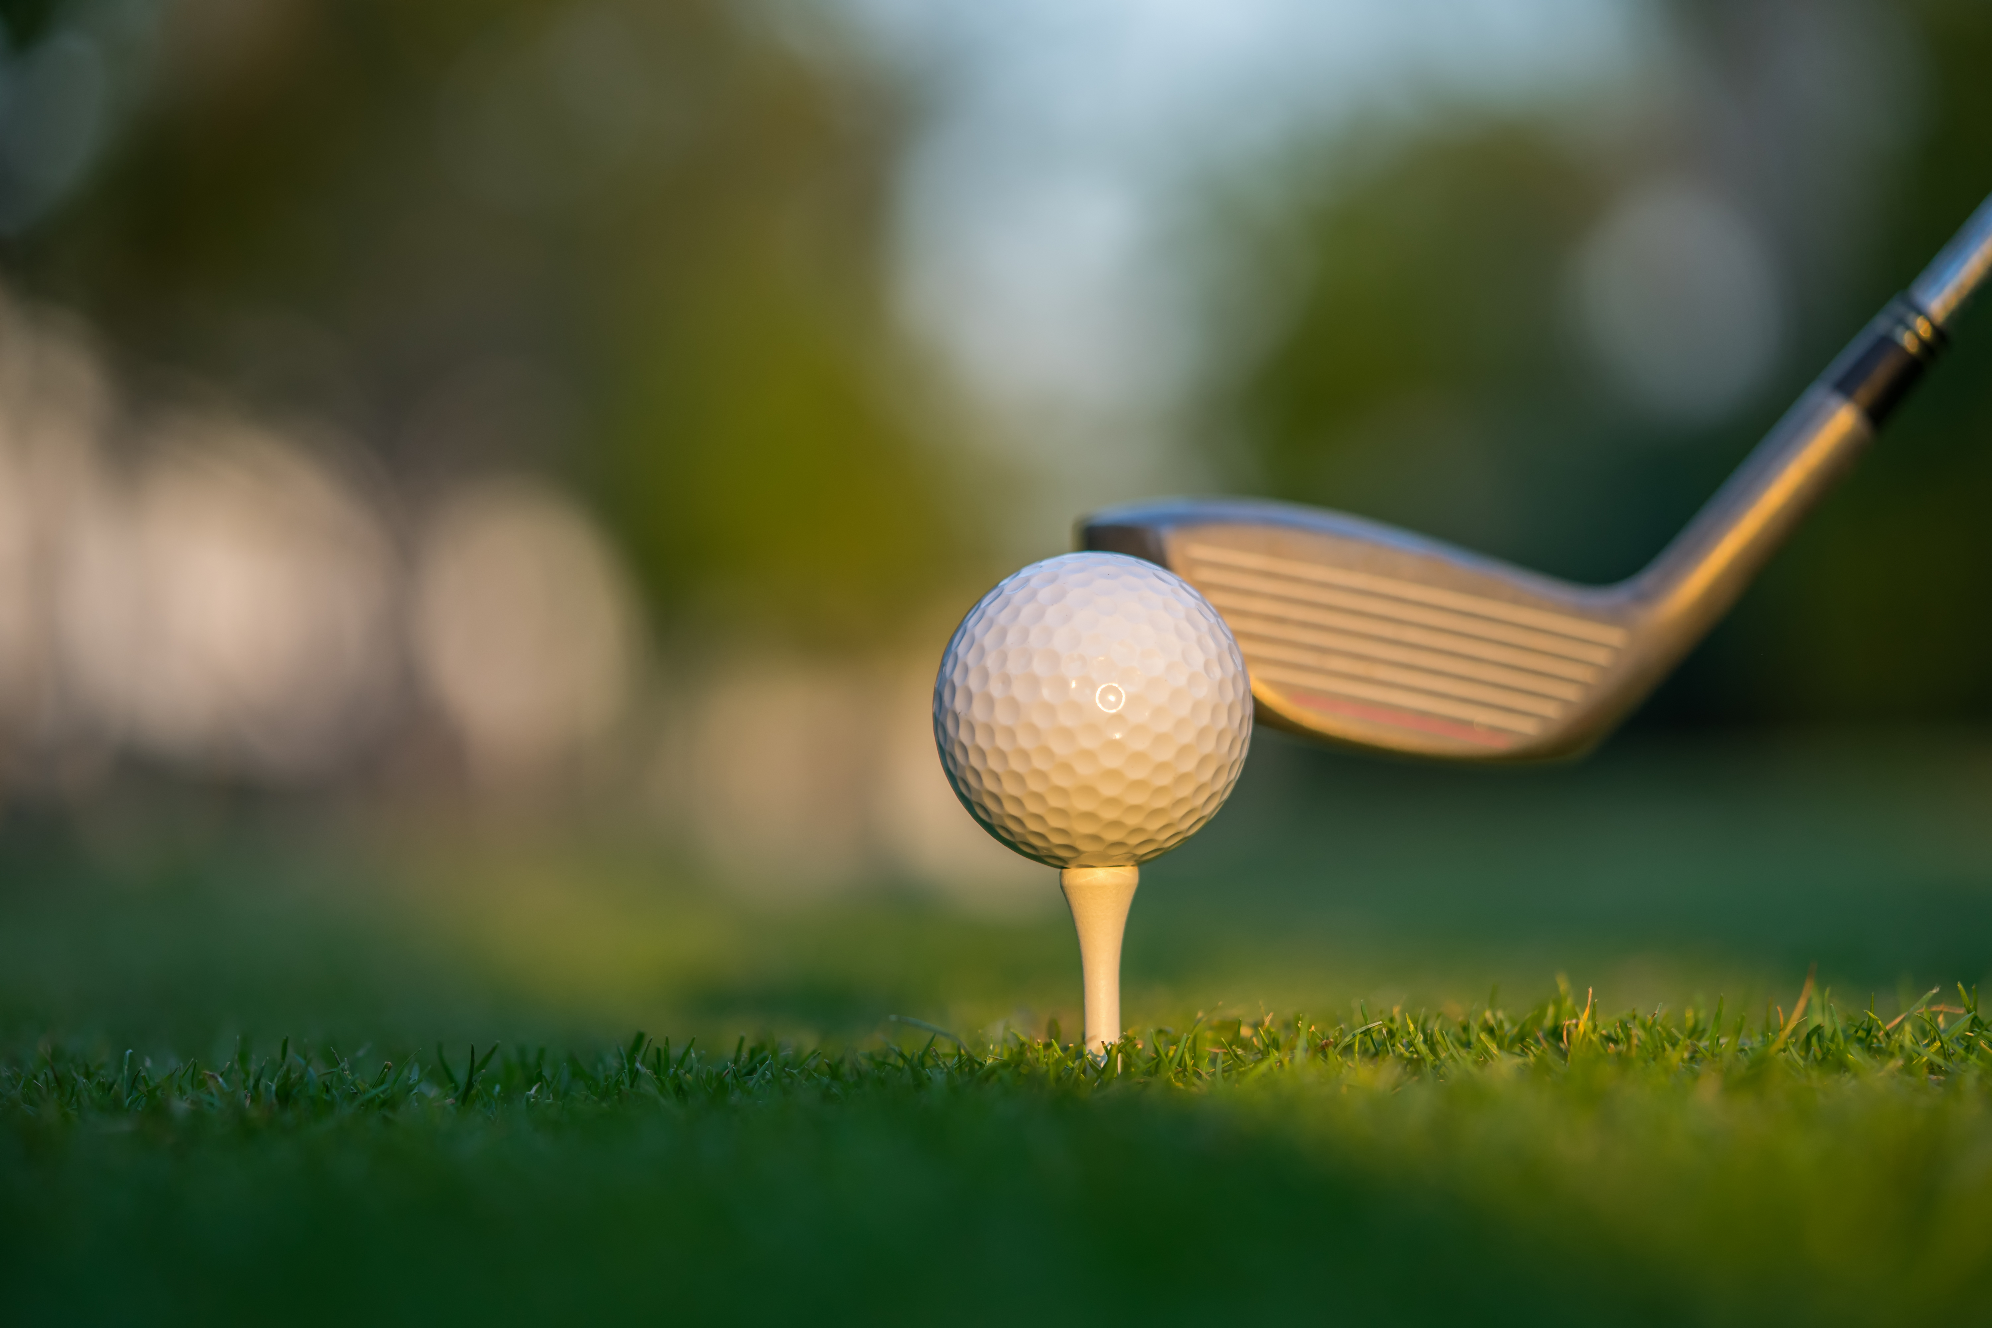
Introduction
Aerodynamics in Golf Club Design
Aerodynamics affects speed, trajectory, and shot stability in golf.
High-end clubs like Callaway XR 16 use advanced materials and designs.
Study compares aerodynamic efficiency with low-end Tour Jr. Driver Head.
Drag and lift forces calculated using fluid dynamics principles.
Notes:
Talking about the Golf Club design, the aerodynamics would affect the speed and trajectory, and the shot stability involved and using high end clubs like Callaway XR16 which uses advanced materials and design it would probably be better, this study compares aerodynamic efficiency with another driver head which is tour junior driver head. The drag and lift forces are calculated using fluid dynamics principles.

Slide 3
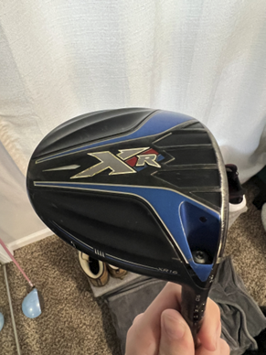
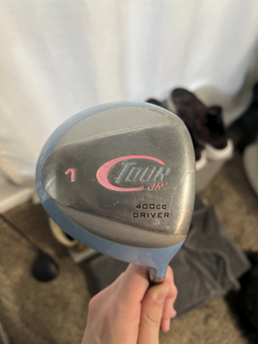
Objective
Compare aerodynamic properties of high-grade and low-grade golf driver heads.
  Calculate Drag Force (Fd)
  Calculate Lift Force (F_{L})
  Calculate Drag Coefficient (Cd)
  Calculate Lift Coefficient (CL)
Callaway XR 16 Driver
(High grade)
Tour Jr. Driver
(Low grade)
Notes:
Talking about the objectives the main objective is to compare aerodynamic properties of high grade and low grade golf driver heads for which we have to calculate the drag forces the lift forces the drag coefficient and the lift coefficient as you can see in the images basically high grade driver head and this is the great driver head
orrect experimental objective stated

Slide 4
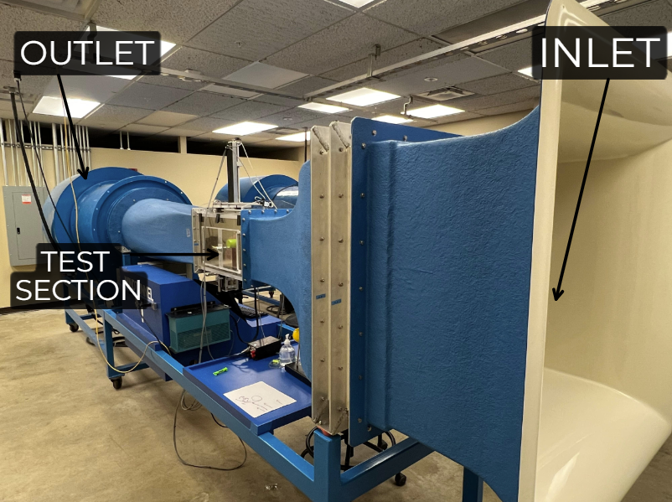
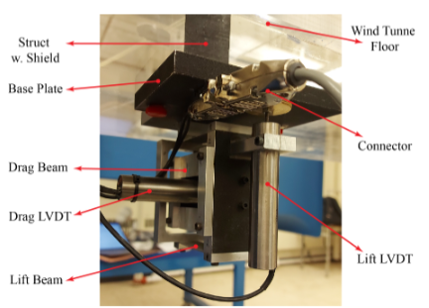
Facility & Instruments
ELD Model 402B Wind Tunnel available within POTR building
  NI USB-6431 VFD device which controls wind tunnel speed from 0 to 60 Hz
Linear Variable Differential Transformer
  Utilizes deflection of beam to calculate applied force
Fig. 3.1.1 ELD Model 402B Wind Tunnel Diagram
Fig. 3.1.2 LVDT Diagram
Notes:
We use the instruments and facilities available within the Potter building its model was field model 402 B and then we use the VFD device which controls the wind tunnel speed from zero to 60 Hertz we also use the LVDT which is the linear variable differential transformer which utilizes the deflection of the beam to circulate the type forces as you can see the images these are the instruments that we used.

Slide 5
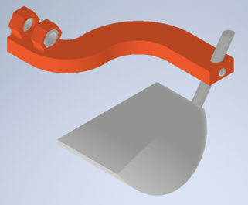
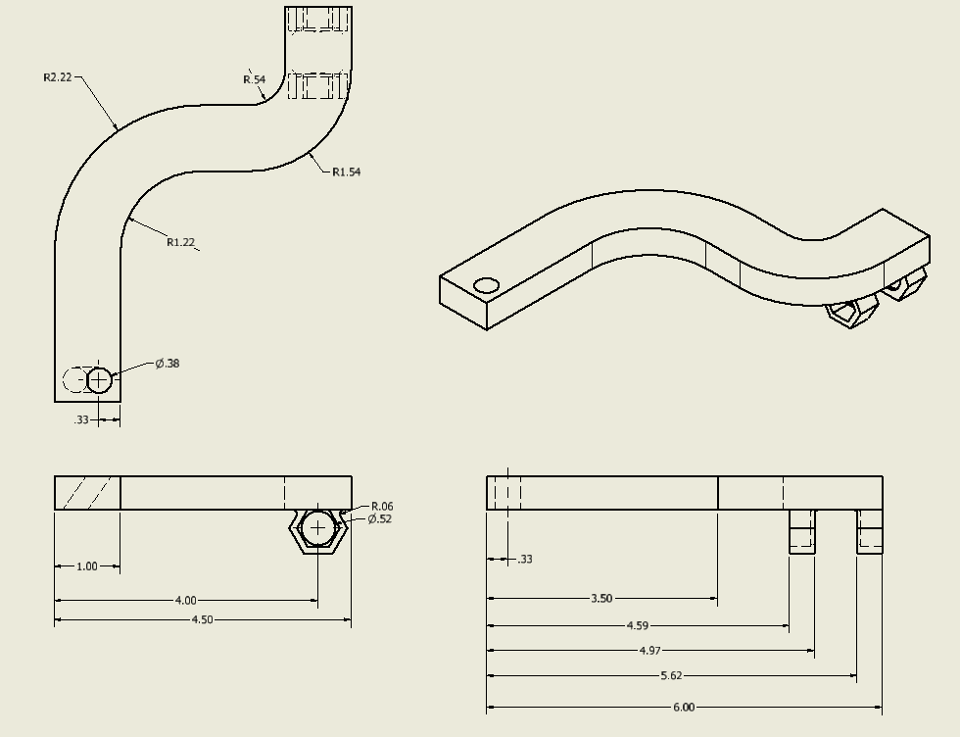
Test Model
Real driver heads were used
3D printed stand to hold driver heads
Fig. 3.2.1 Full CAD Assembly. Assembly includes the driver head, the driver head holder, 2x 3/8”-16 thread hex nuts, and a screw.
Fig. 3.2.2 Driver head holder CAD drawing in inches.
Notes:
For this experiment we wanted to use the actual driver heads. Thus we needed to create a mount to be able to hold the driver heads to attach it to the LVDT. The mount was 3D printed and had 2 3/8”-16 threaded hex nuts to be slotted in and a screw to hold the shaft of the driver in place. The figure on the left shows the full assembly and the figure on the right shows the CAD necessary for manufacturing the mount.

Slide 6
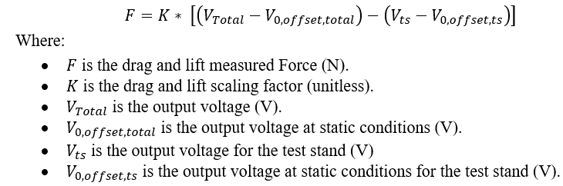
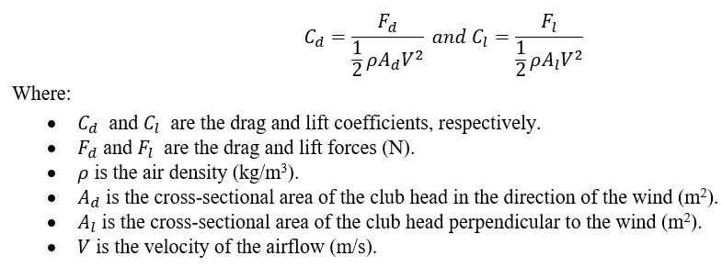
Test Plan
Notes:
To determine the success of our experiment, we calculated several key parameters. We utilized the LVDT to directly determine the drag force acting upon the drivers, then calculated the coefficient of drag and lift for the driver head based on the shown equations.

Slide 7
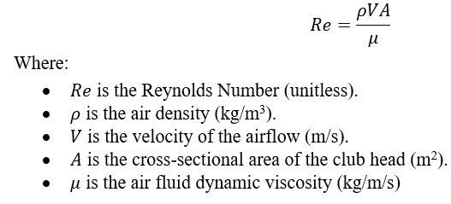
Test Plan
Table 3.3.1 Experimental Reynold Number Values.
Golf Club | Callaway XR 16 | Tour Jr.
Wind Speed Range (Hz) | 30 – 60 | 30 – 60
Reynolds Number Range | 1.00 x 10⁵ – 2.118 x 10⁵ | 9.884 x 10⁴ – 2.093 x 10⁵
Drag Area (m²) | 0.0054 | 0.0053
Lift Area (m²) | 0.014 | 0.0124
Notes:
Furthermore, we calculated Reynolds number to create a graph of the changes in aerodynamic properties for increasing Reynold value, the specific equation for which is listed in the above. The experiment was preformed over a range of wind speed values as shown in the table: From a range of 30 Hz to 60 Hz wind speeds and with the drag and lift area of the driver heads already determined.

Slide 8
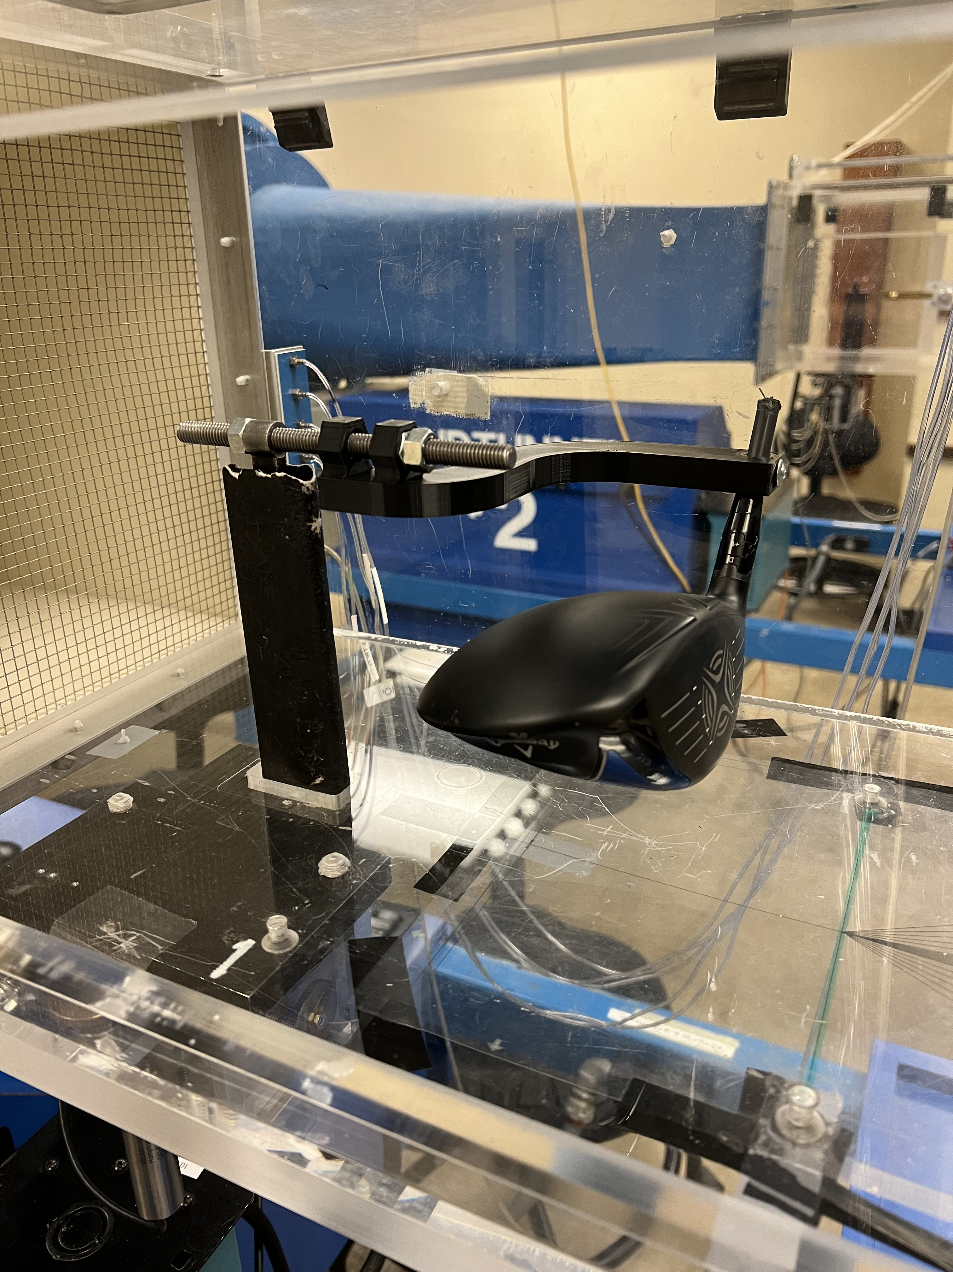
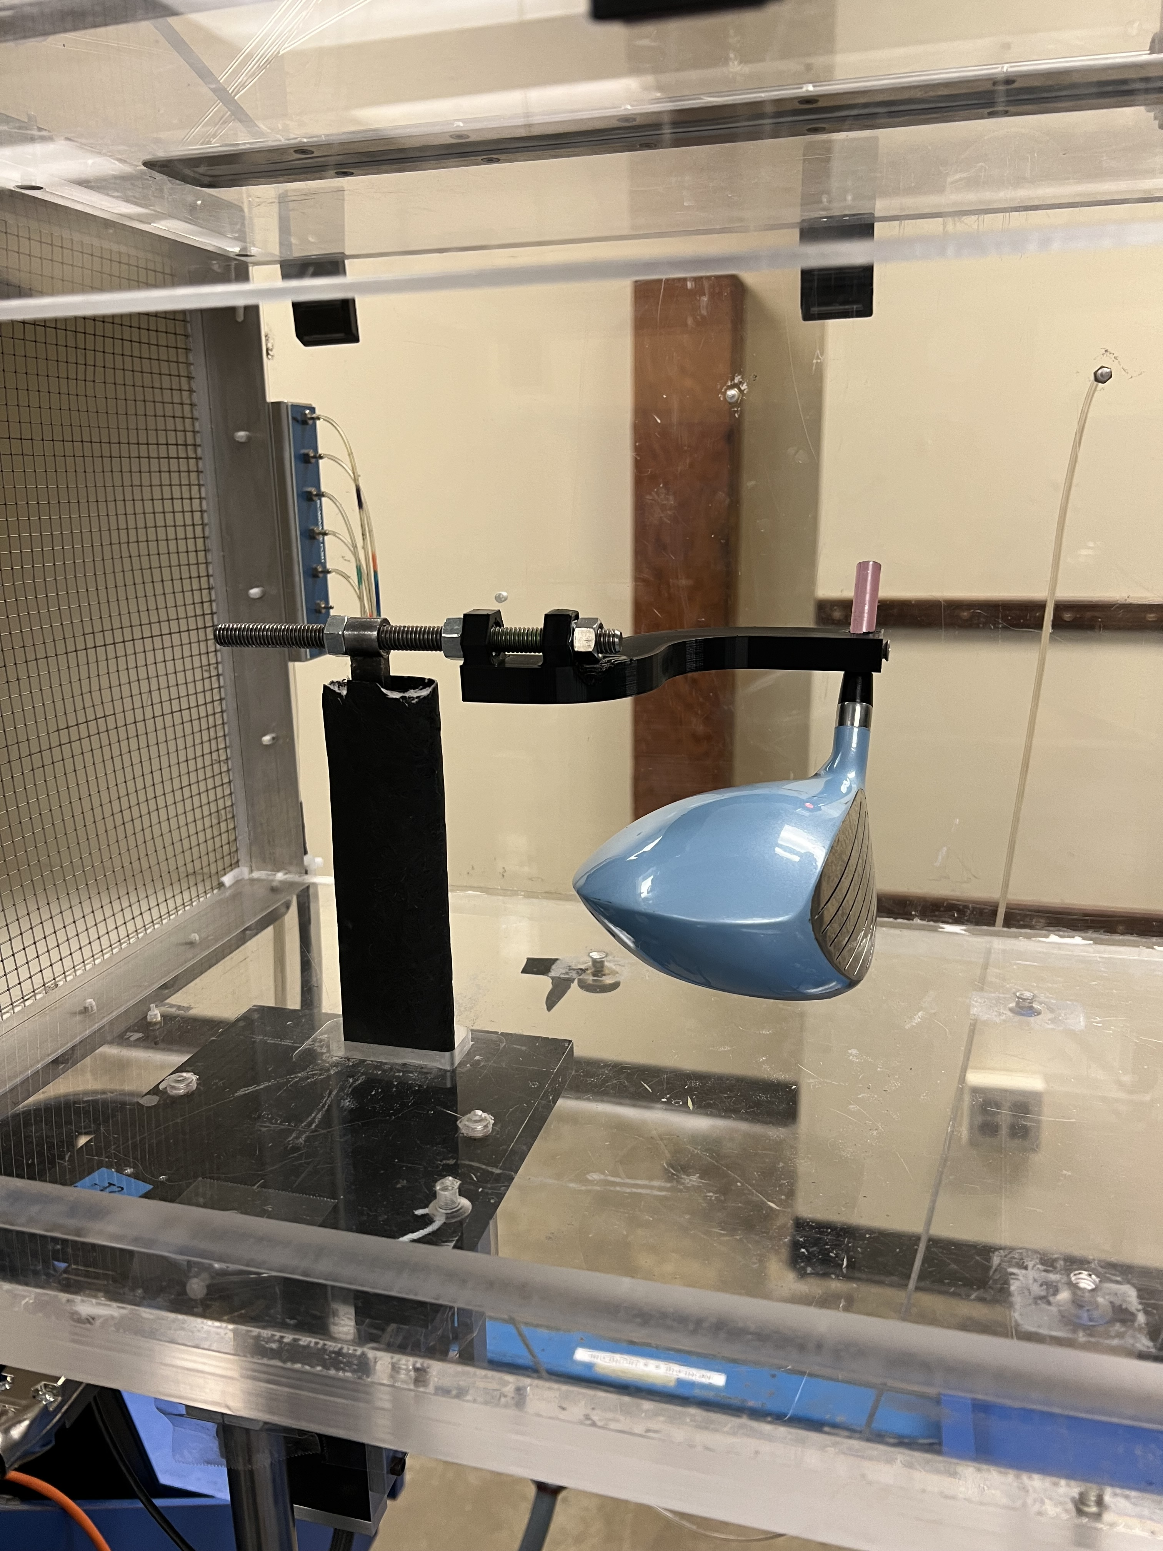
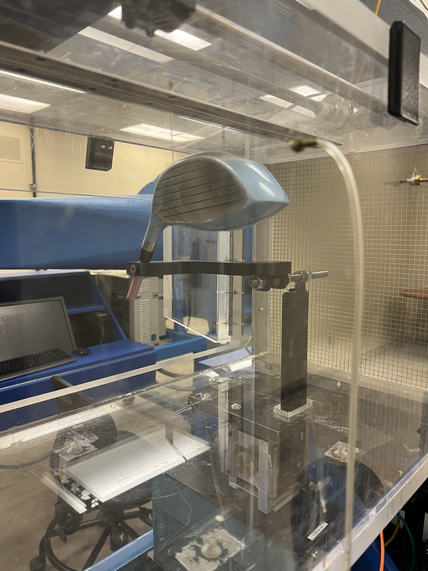
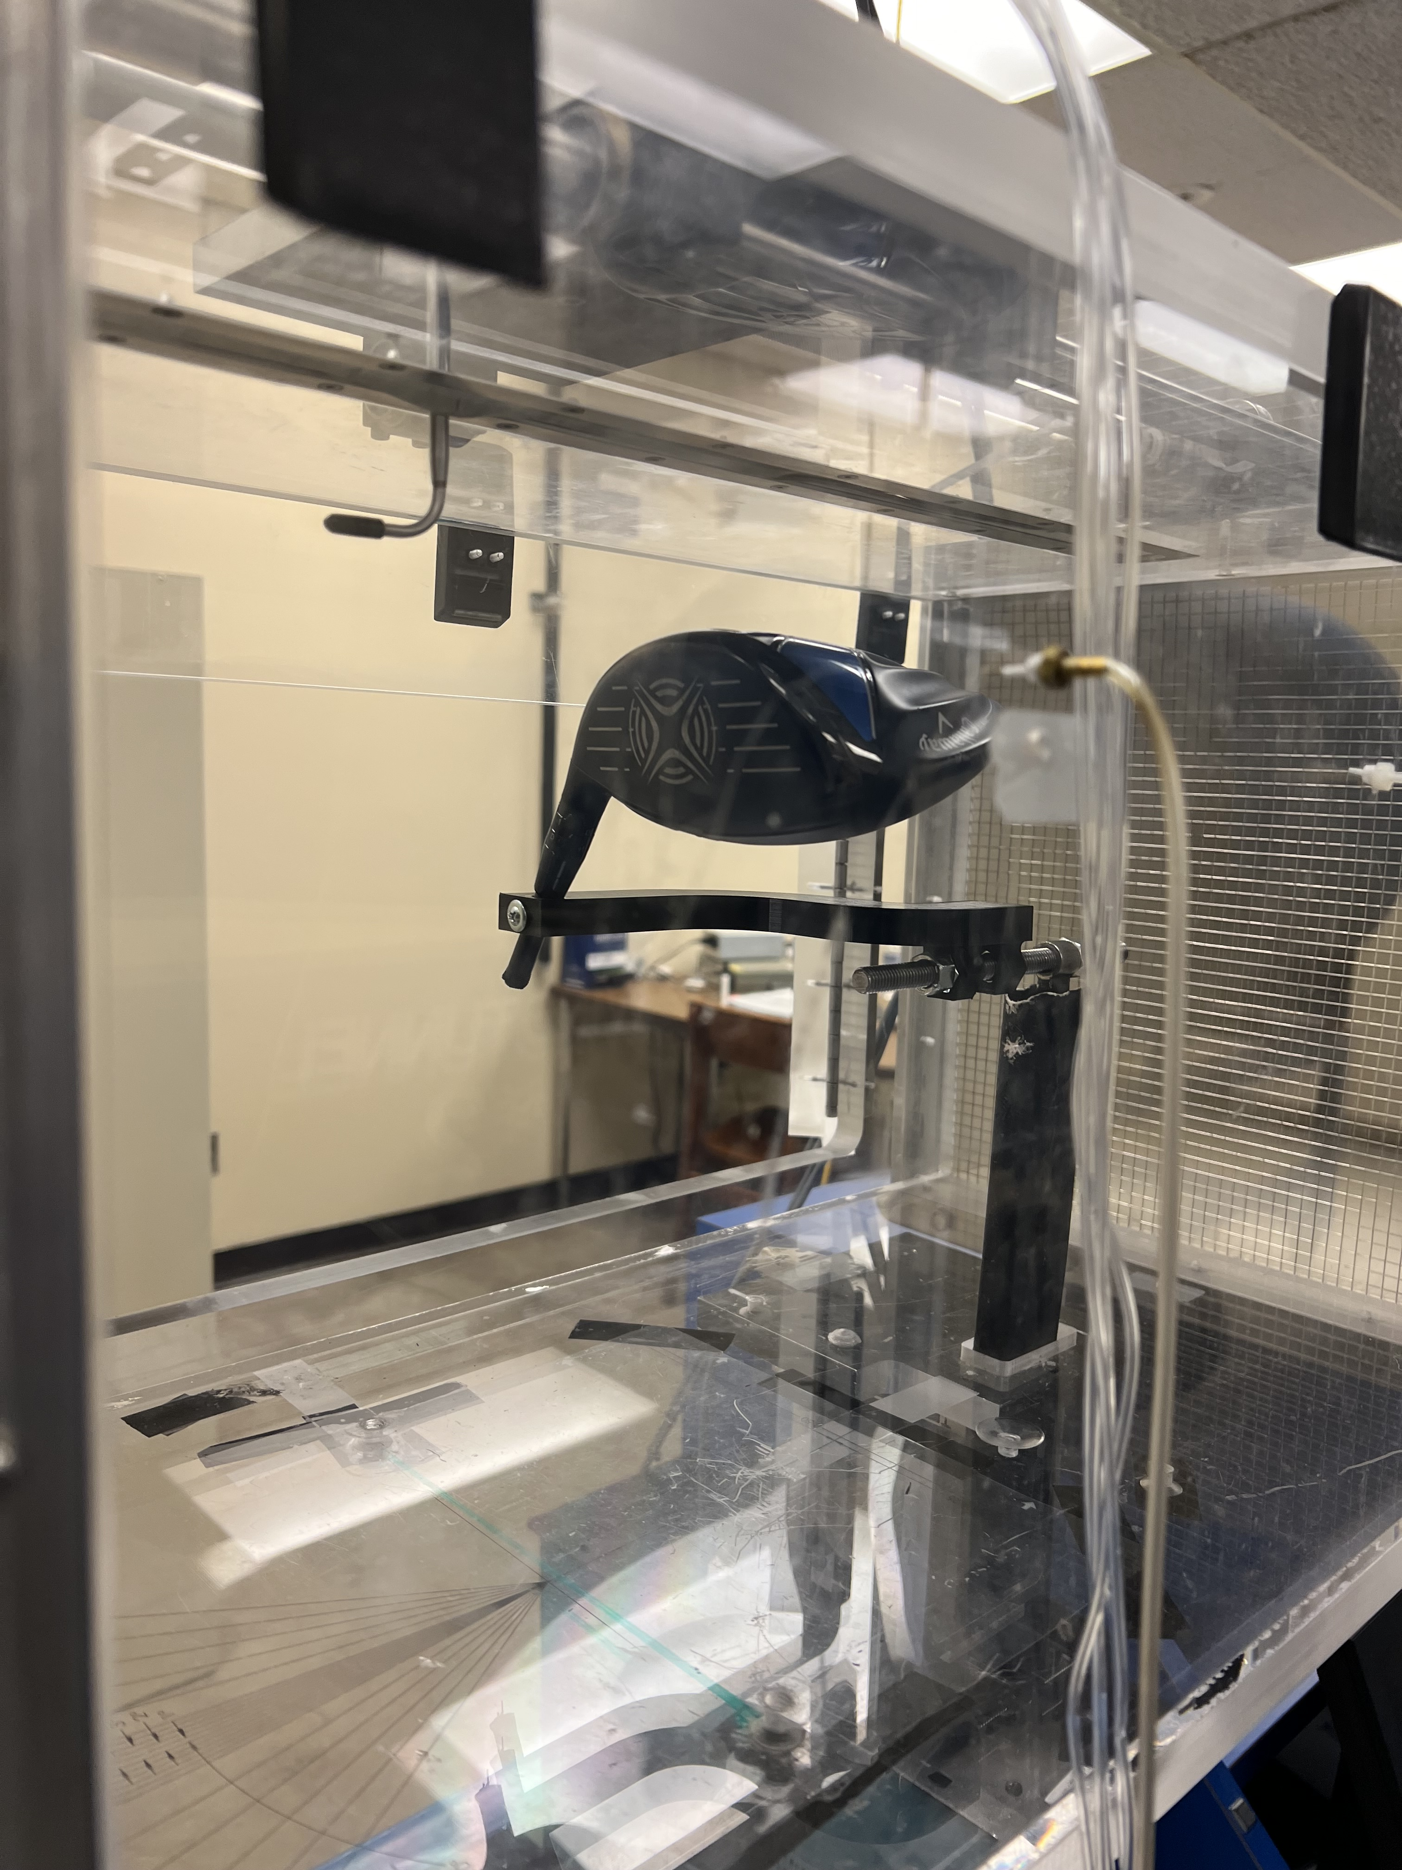
Test Plan
Mount Driver Head Holder onto the dynamometer
Recording drag and lift forces with no wind
Collect the values for wind speed ranging from 30 Hz (20.9 m/s) to 60 Hz (44.8 m/s) in 5 Hz increments.
Rotate the head holder 180 degrees and repeat measurements.
Perform for both the Callaway XR 16 Driver Head and the Tour Jr. Driver Head.
Calculation of aerodynamic forces and coefficients.
Fig. 3.4.1 Tour Jr within the test section in the Impact and Upside-Down position (left, right).
Fig. 3.4.1 Callaway XR 16 within the test section in the Impact and Upside-Down position (left, right).
Notes:
The first step of the test plan was to mount the Callaway driver head onto the dynamometer and operate the sensor equipment at 0 Hz to calibrate the system. Next, we will collect the measured drag force for wind speeds ranging from 30 to 60 Hz within 5 Hz increments. To account for different aerodynamic properties, the driver head was rotated 180° and the same measurements taken. Finally, the Callaway driver was dismounted and replaced with the low-grade Tour junior drive head, and we repeated all the previous measurements on it.

Slide 9
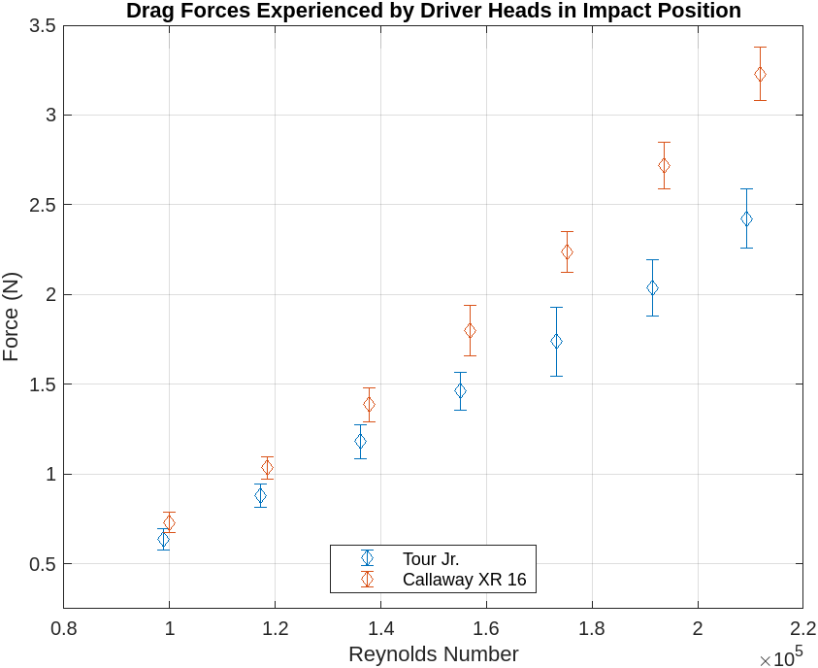
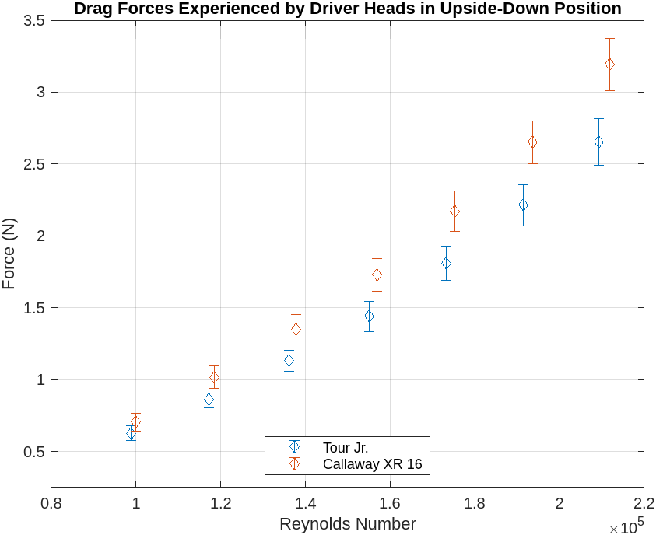
Results
Fig. 4.1.1 Measured drag force experience on both driver heads in the Impact Position. Error bar is at a 95% confidence interval.
Fig. 4.1.2 Measured drag force experience on both driver heads in the Upside-Down Position. Error bar is at a 95% confidence interval.
Notes:
Let’s now examine the experimental results. The drag force experienced by the driver heads in both the impact and upside-down positions is similar for each model. However, the cheaper Tour Junior driver head experiences less drag in both positions.

Slide 10
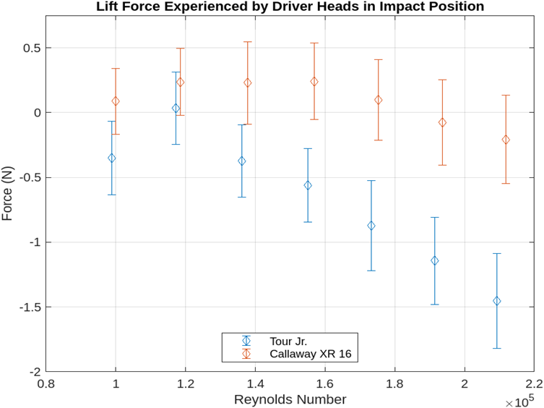
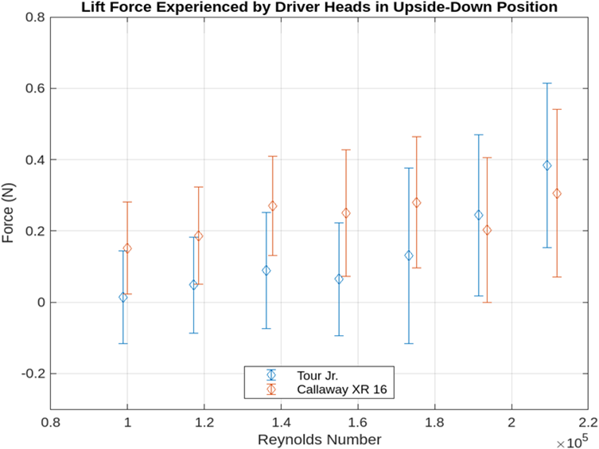
Results
Fig. 4.1.3 Measured lift force experience on both driver heads in the Impact Position. Error bar is at a 95% confidence interval.
Fig. 4.1.4 Measured lift force experience on both driver heads in the Upside-Down Position. Error bar is at a 95% confidence interval.
Notes:
When analyzing the lift force, in the impact position, the Tour Junior driver head experiences a negative force, indicating downforce rather than lift. Similarly, the Callaway RX16 also experiences downforce, but the Tour Junior exhibits greater downforce. In the upside-down position, both drivers display comparable upward forces, which still represent downforce due to the 180° rotation.

Slide 11
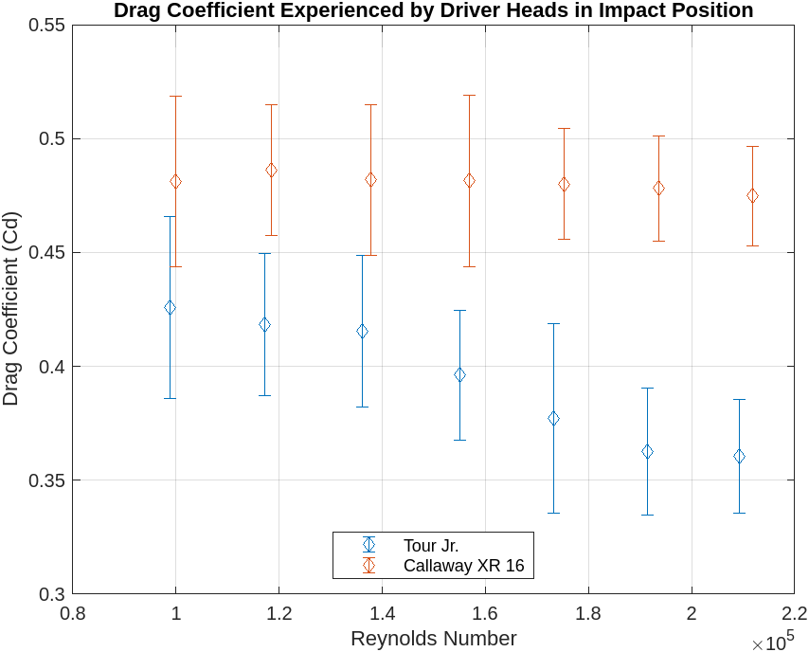
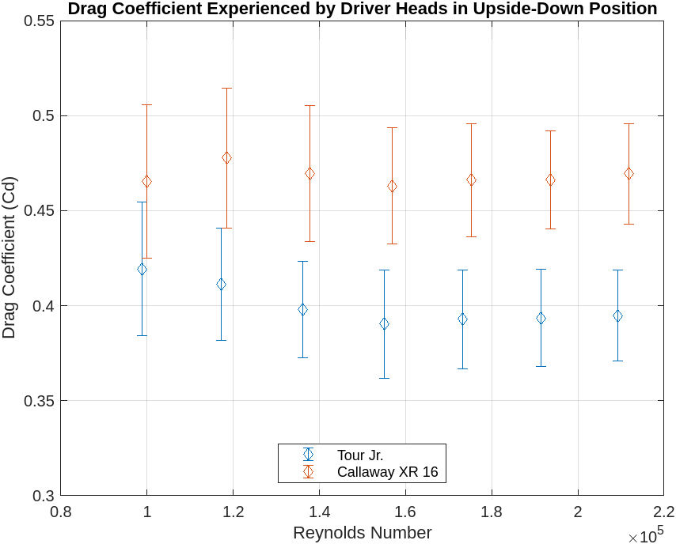
Results
Fig. 4.2.1 Measured drag coefficient experience on both driver heads in the Impact Position. Error bar is at a 95% confidence interval.
Fig. 4.2.2 Measured drag coefficient experience on both driver heads in the Upside-Down Position. Error bar is at a 95% confidence interval.
Notes:
Calculations for drag coefficients reveal that the Callaway RX16 maintains a stable drag coefficient of approximately 0.475 across all Reynolds numbers, whereas the Tour Junior shows a gradual decrease in drag coefficient as the Reynolds number increases. In the upside-down position, the Callaway RX16 remains stable around 0.475, while the Tour Junior fluctuates around 0.4.

Slide 12
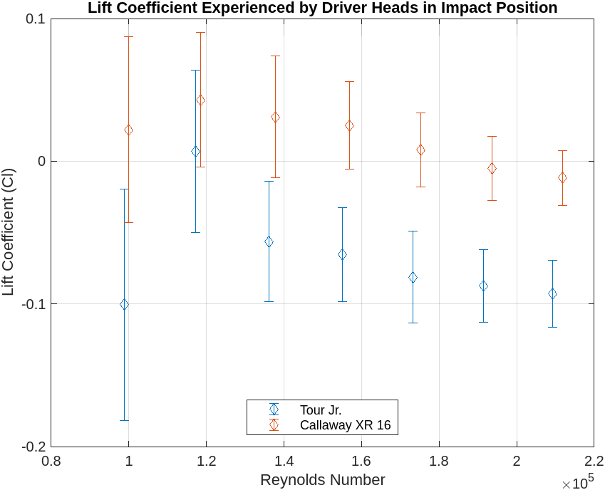
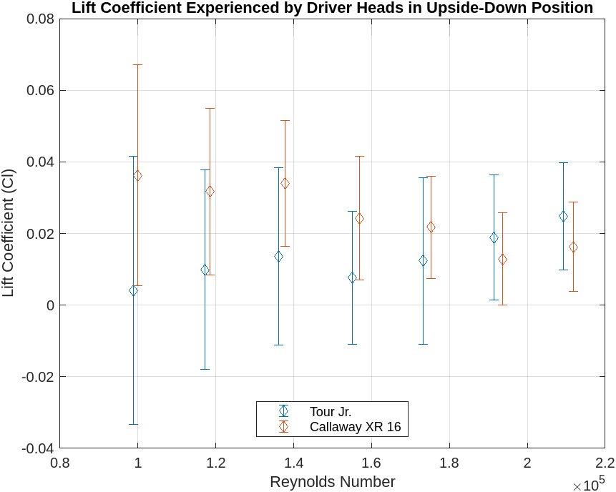
Results
Fig. 4.2.3 Measured lift coefficient experience on both driver heads in the Impact Position. Error bar is at a 95% confidence interval.
Fig. 4.2.4 Measured lift coefficient experience on both driver heads in the Upside-Down Position. Error bar is at a 95% confidence interval.
Notes:
Examining the lift coefficients, both driver heads exhibit negative values in the impact position, indicating that they generate downforce rather than lift. This downforce appears to increase as the Reynolds number rises. In the upside-down position, both driver heads display similar trends, with the lift coefficients also indicating downforce due to the reversed orientation.

Slide 13
Key Findings
High-grade Callaway club experienced more drag than low-grade Tour club. This correlated to difference in drag coefficients between the two.
Callaway club measurements were more consistent with on-average smaller confidence interval magnitudes
Force and coefficient calculations for lift included overlapping confidence intervals' between the two driver heads, it cannot be said if there is a significant difference for lift calculations.
Our initial assumption that high-grade club would experience lower drag was found to be false.
Notes:
The key findings of our experimented were that the high-grade Callaway club experienced more drag force than the low-grade torque tower club, which correlated to the Callaway club having a larger drag coefficients than the lower grade Tour club. The Callaway club also had more precise measurements with lower confidence interval magnitudes. Measurements for the lift force had overlapping confidence intervals between the different drives, thus a significant difference in lift force between the two clubs cannot be determined. Finally, our initial assumption that the high-grade club would experience the least amount of drag was found to be false.

Slide 14
Future Work
Utilize larger sample size of driver heads to determine if behavior holds true in general.
Preform experiment over range of price point (ex. 10 USD vs. 50 USD vs. 100 USD clubs) to determine correlation in aerodynamic behavior and grade/pricing.
Preform the experiment with different brands
Utilize spring to dampen vibrations and reduce error in future wind tunnel measurements.
Notes:
For future experiments, we recommend utilizing a larger sample size to determine if the behavior we found holds true or If this is the exception. We also recommend performing the experiment on a wider range of different price points in order to determine if there is a definitive correlation with aerodynamic properties, as well as with different brands. Finally, to minimize vibrations which caused a significant amount of error in this experiment, we recommend utilizing springs to reduce measurement error and prevent one of the main limitations of this experiment.

Slide 15
References
Lab3, Mechanical School of Engineering, (2024)
Openstax (n.d.) https://openstax.org/books/university-physics-volume-1
Notes:
The key discovery is concluded and suggestion for future work is given.

Slide 16
Thank You!

Slide 17
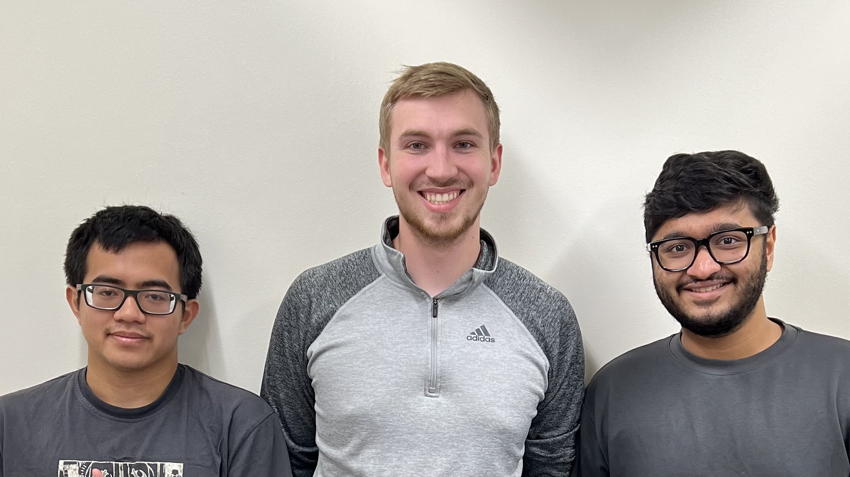
Rifqi Sambodo, Jackson Emerson, Dev Lekhadia (Left, Middle, Right)

