Slide 1

Optimal Fin Design with Volume Constraint
Jackson Emerson, McKenna Marlar, Lohit Bhatnagar, Charlie Sledz

Slide 2
Introduction & Project Objective
Our objective is to determine which fin geometry dissipates the most heat under a fixed volume constraint: cylindrical, rectangular, and conical.
Fins are used in HVAC, electronics, and automotive applications to dissipate heat efficiently.
  Their performance depends on material, airflow, and most critically — geometry.
Results can be found through analytical calculations relating to heat dissipation and can help optimize compact thermal designs for energy efficiency.

Slide 3
Hypothesis & Assumptions
Hypothesis:
Assumptions:
Radiation is negligible.
No internal heat generation occurs.
Steady-state heat transfer is reached.
Bottom & sides of the fin base are perfectly insulated.
1D heat flow.
Cylindrical fin will dissipate more heat per unit mass
Rectangular fin will dissipate the most heat in the given boundary box

Slide 4
Material & Equipment Utilized in Lab
Aluminum blocks
Heater
Thermocouples
IR camera
Mill
Lathe
Insulation
Black paint
Blower box
Anemometer

Slide 5
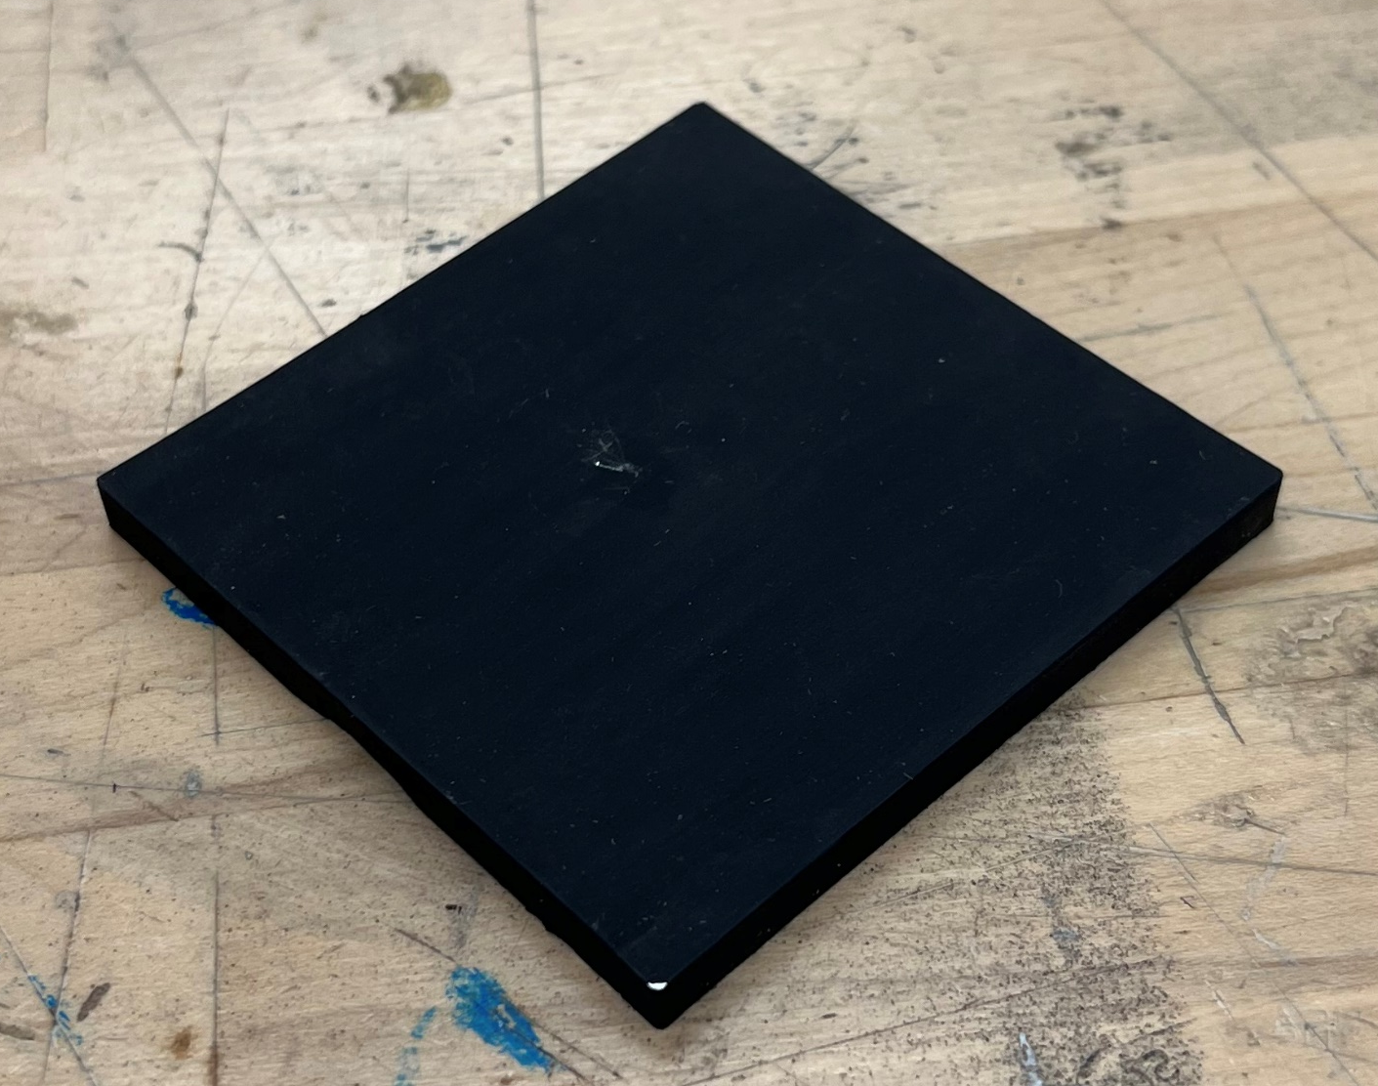
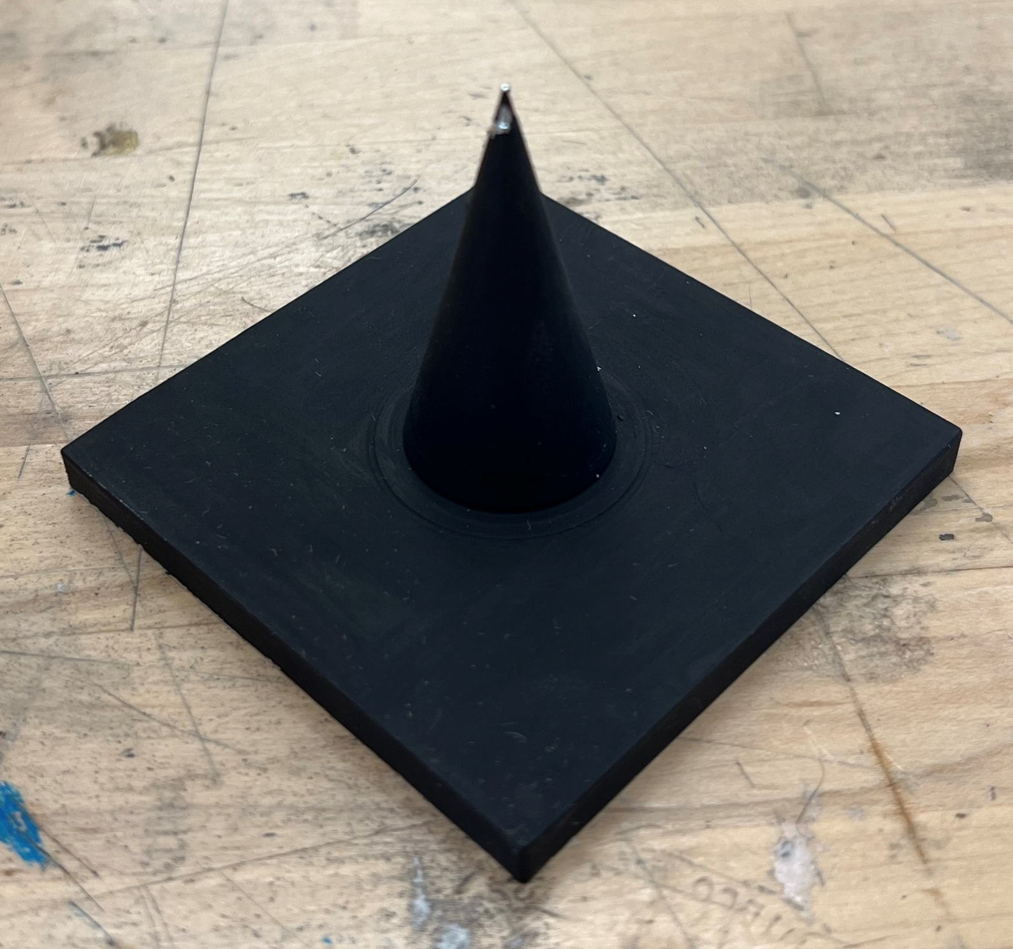
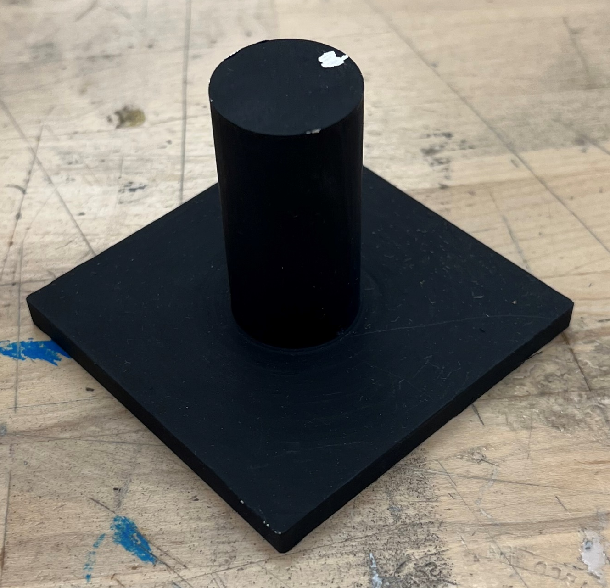
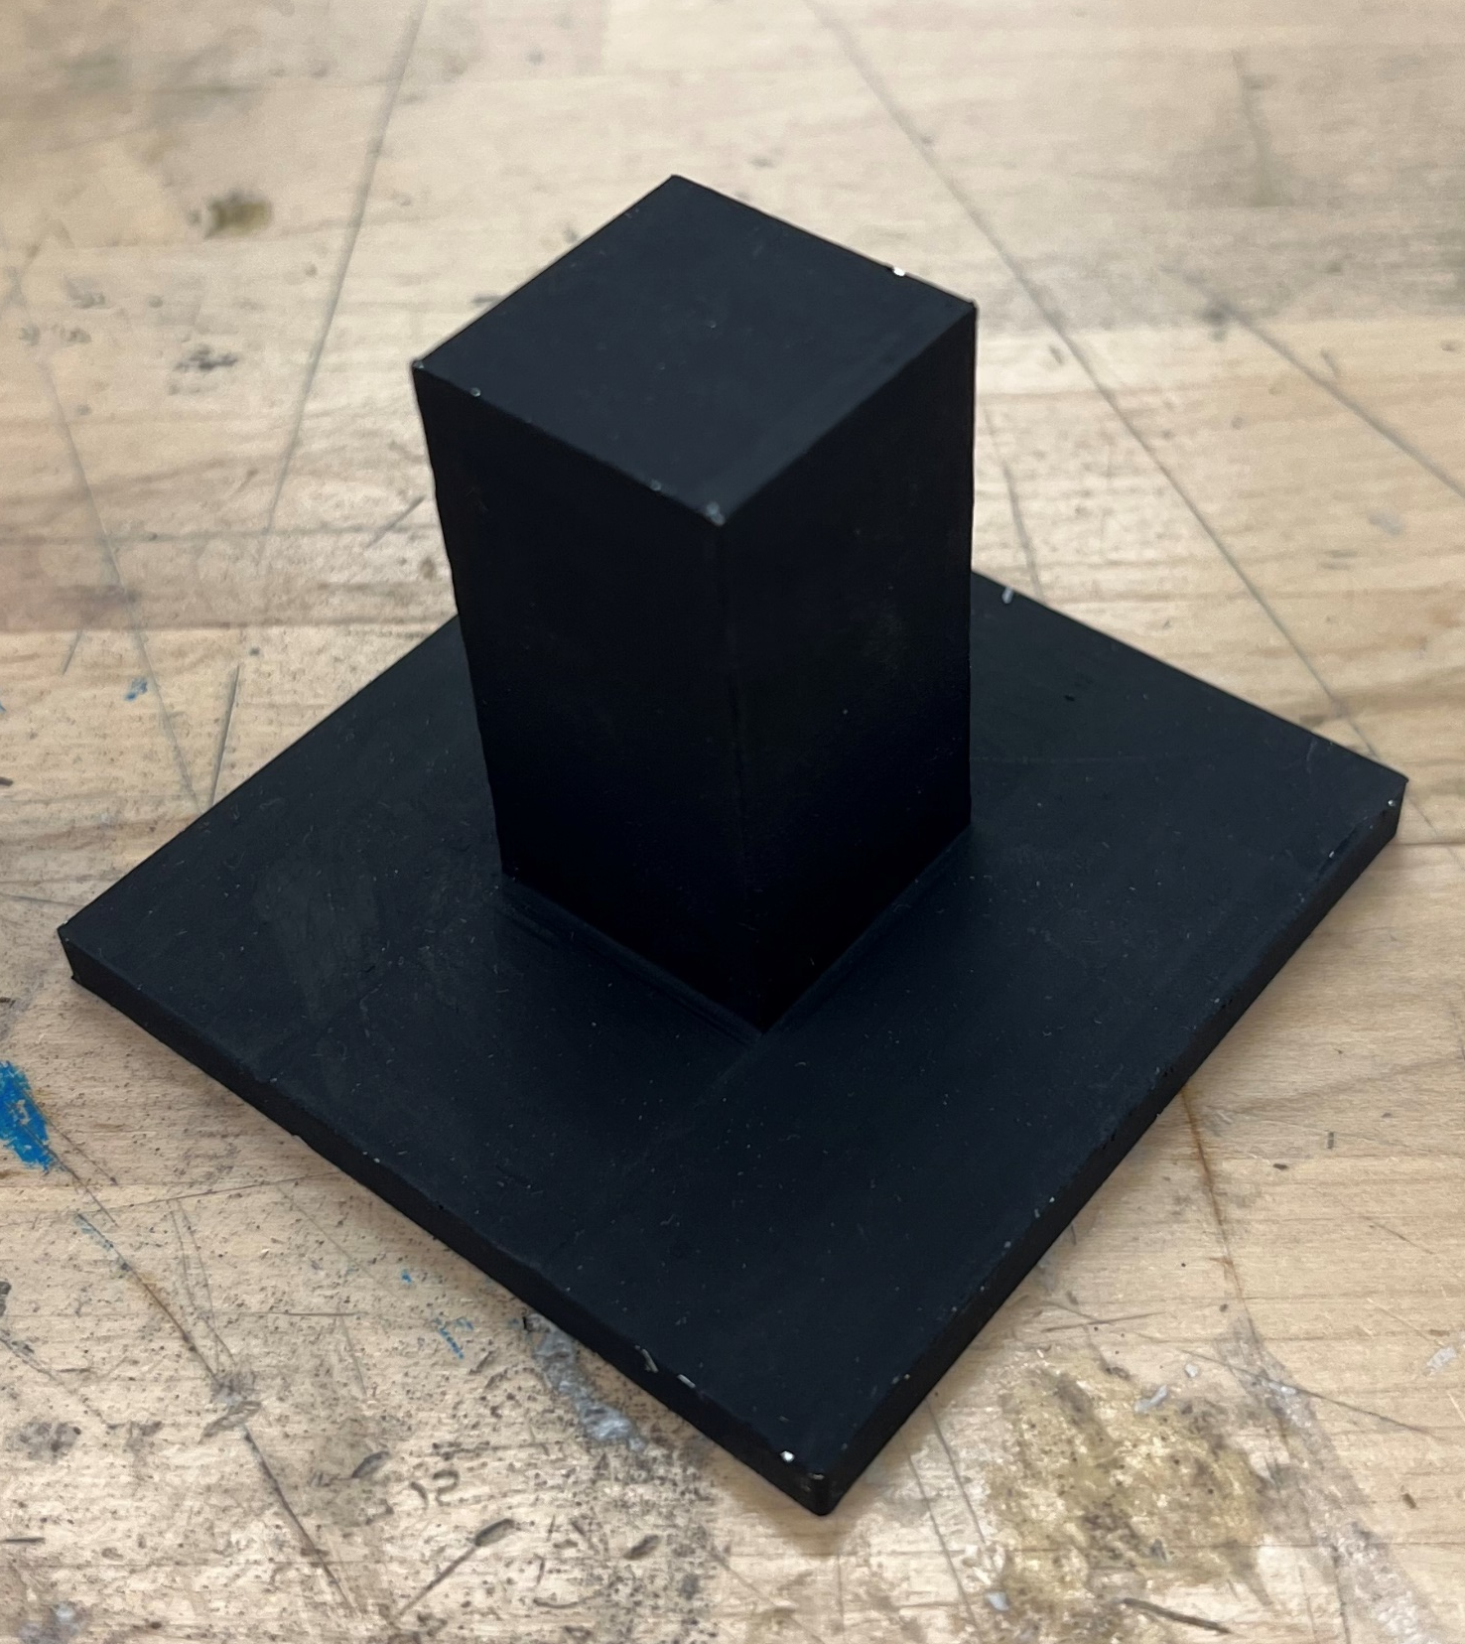
Fabrication
Plate
Rectangular
Conical
Cylindrical

Slide 6
Experimental Setup
Fins machined from aluminum 6061 block with different geometries (rectangular, cylindrical, conical)
Heated from the base using an electric heater
Base and heater situated in insulation
Air flow across fin via a blower to induce forced convection
Thermocouples measure temperature at fin base and tip

Slide 7
Experimental Setup
h, T∞
h, T∞
Blower
Blower

Slide 8
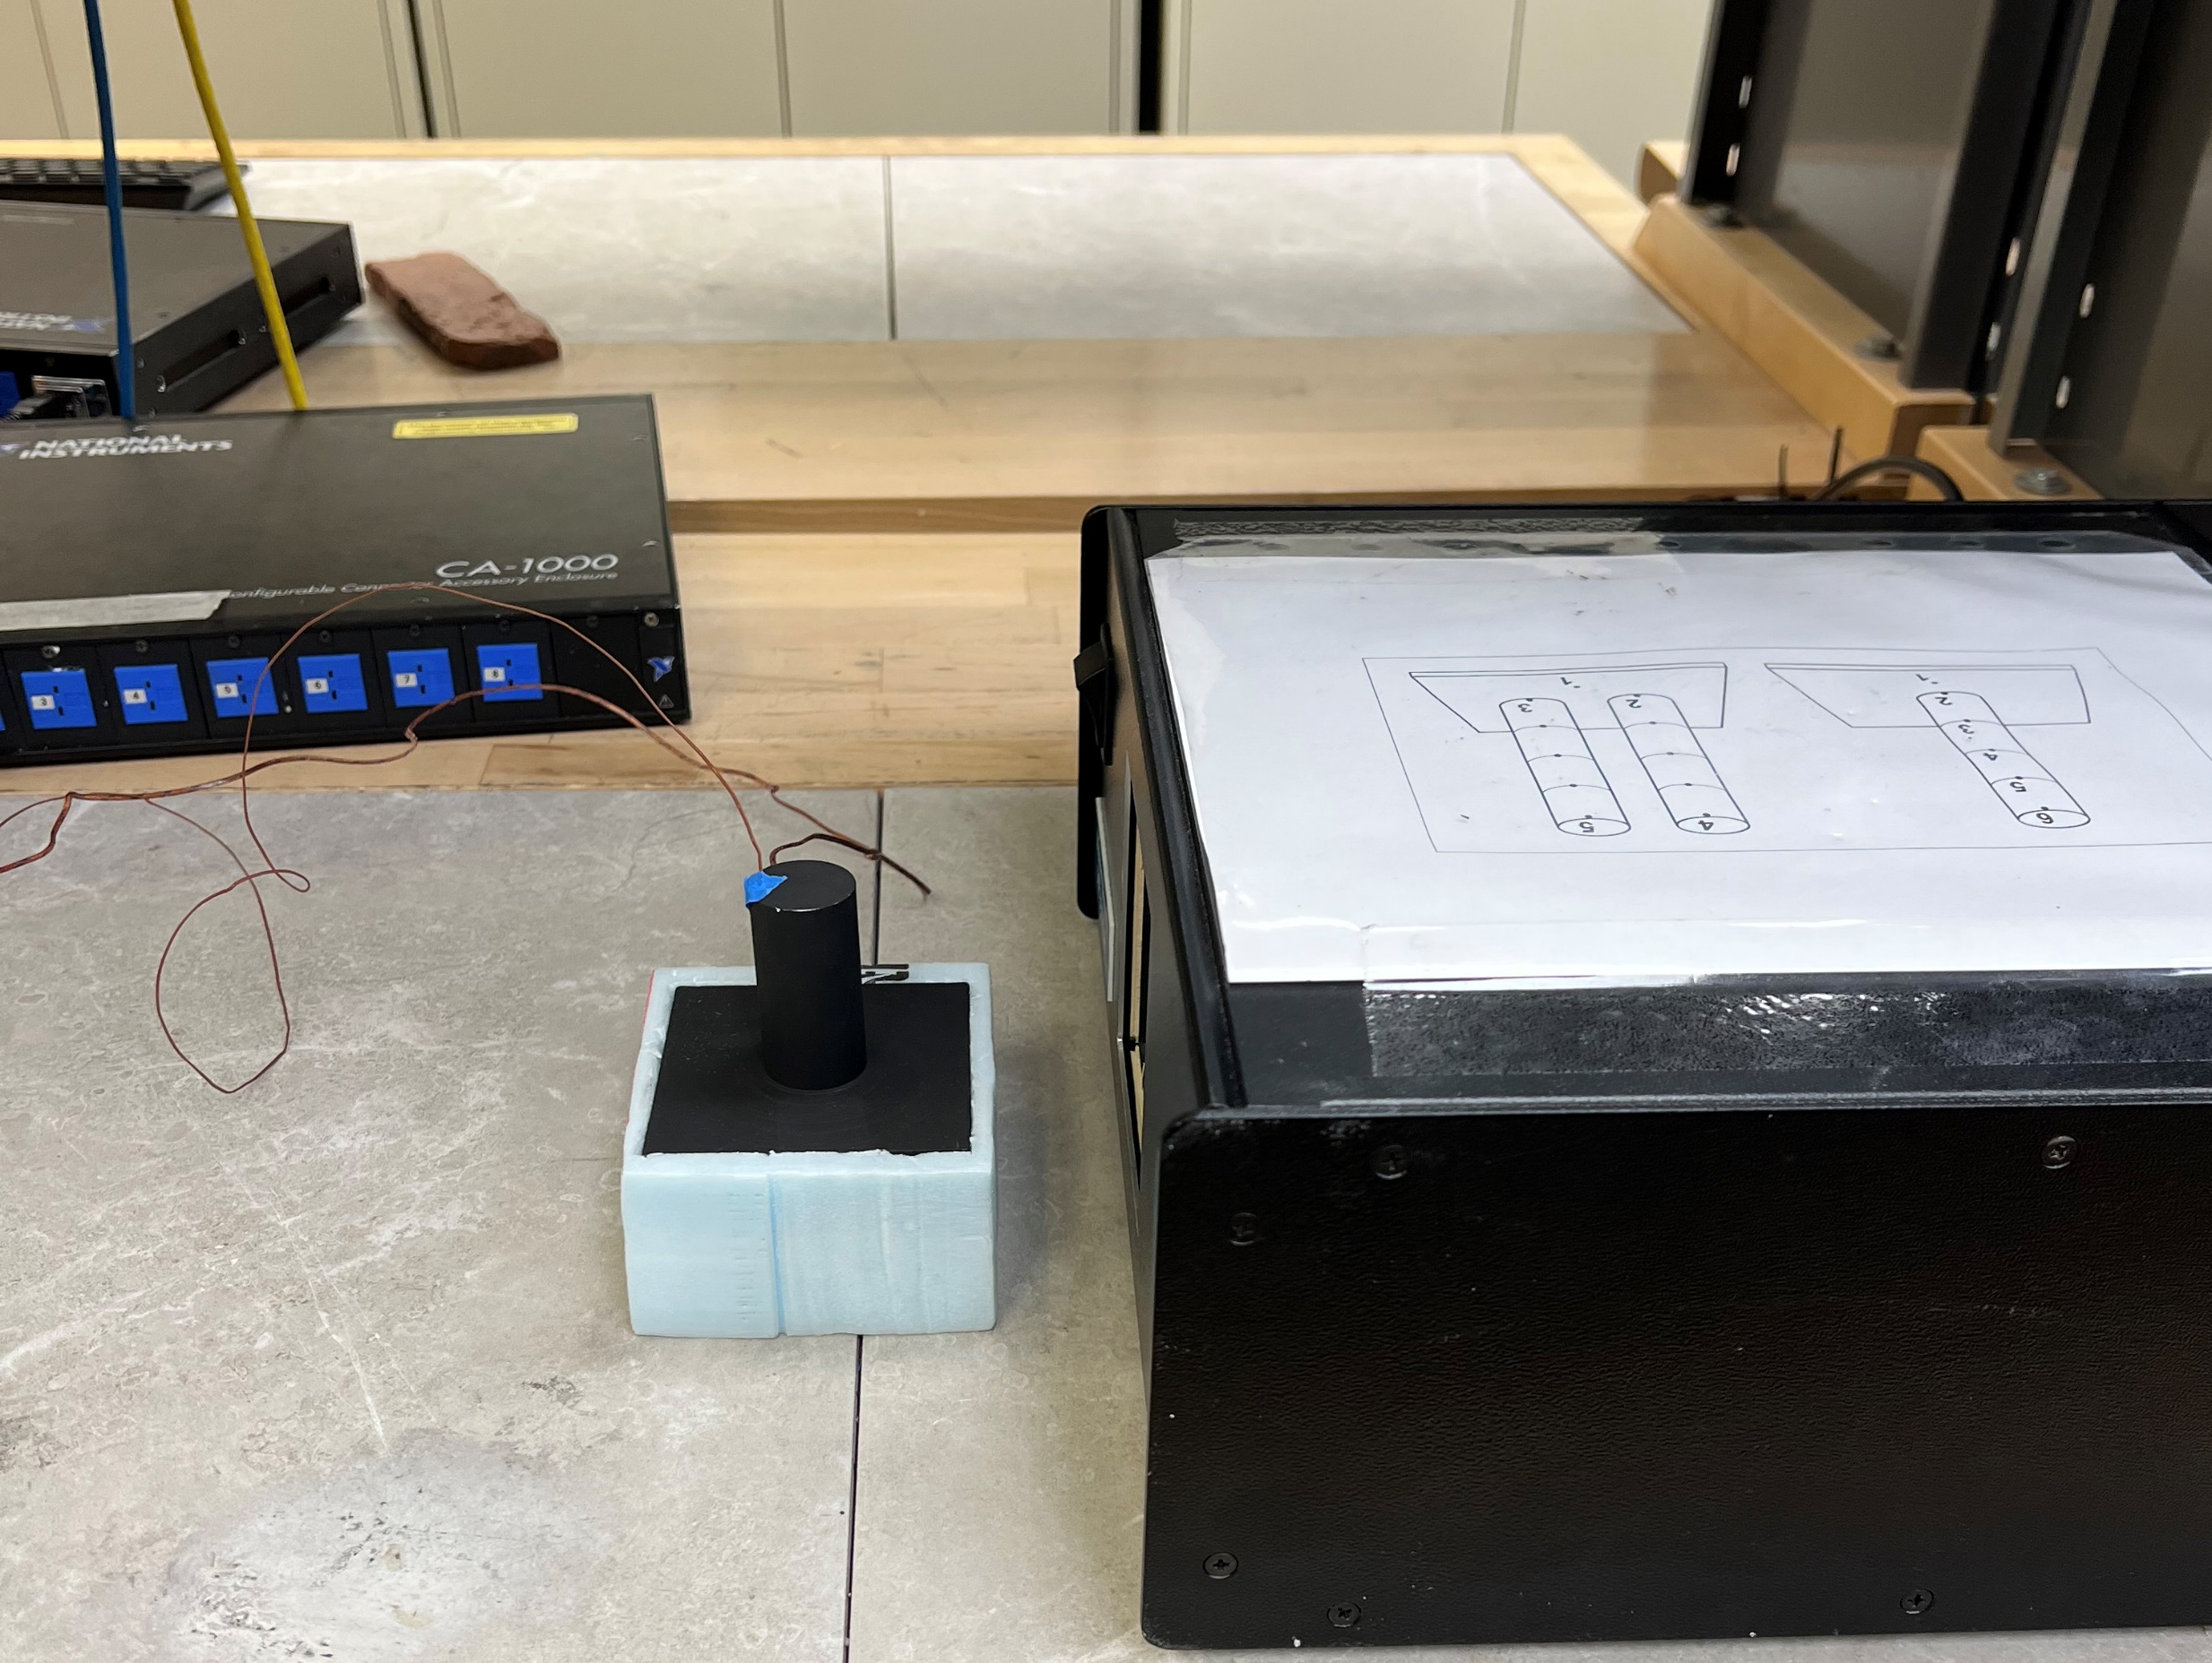
Experimental Setup

Slide 9
Experimental Procedure
Set up airflow
Position the blower box directly next to the fin array to simulate forced convection across the surface.
Prepare sensors
Insert thermocouples at the base and tip of the fin to record temperature differences accurately.
Configure power input
Connect a wattmeter to the powerstat, ensuring a measurable power supply.
Calculate power input
Use the wattmeter readings to determine the constant electrical power being supplied to the fin base
Connect them to LabVIEW for real-time data monitoring.

Slide 10
Experimental Procedure
Heat the system
Activate the electrical heater and allow the system to reach steady-state conditions before taking any measurements.
Record data
Monitor and log temperature readings continuously once steady state is achieved. Confirm stability in measurements before finalizing data.
Capture visual data
Use the IR camera to take thermal images of the fin surface to visualize temperature gradients and heat dissipation patterns.
Repeat for all geometries
Perform the same procedure for each fin shape (rectangular, cylindrical, conical), maintaining identical test conditions for consistency.

Slide 11
Schematic – Side View
1 in
2 in
q_{fin}
q_{fin}
q_{fin}
q_{cond}
q_{cond}
q_{cond}
q_{conv}
q_{conv}
q_{conv}
P_{elec}
P_{elec}
P_{elec}
Rectangular
Conical
Cylindrical

Slide 12
Schematic – Top View
1 in
1 in
Rectangular
Conical
Cylindrical

Slide 13
Analysis Overview
Determine thermal resistance of the heated base plate
Find the heat loss through the base material to isolate the heat being transferred through the fins alone.
Calculate the convective heat transfer coefficient
Use known surface temperatures and heat input to estimate the convection coefficient between the fin surfaces and the air.
Measure the thermal resistance of each fin geometry
Using the base and tip temperatures recorded by thermocouples, calculate R(fin)
Determine fin efficiency
Compute fin efficiency η for each shape, accounting for non-ideal losses. Higher efficiency implies more heat is transferred relative to a perfectly conducting fin.

Slide 14
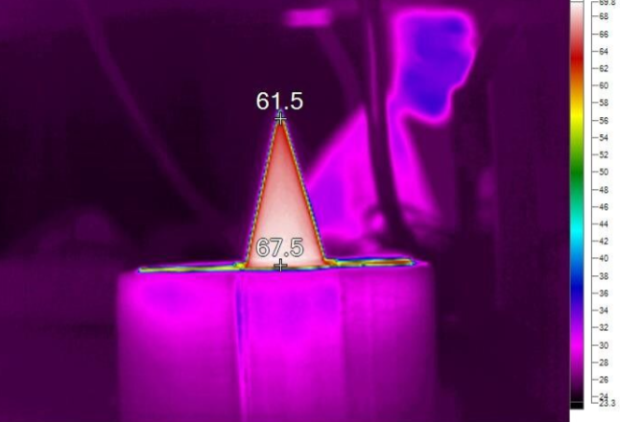
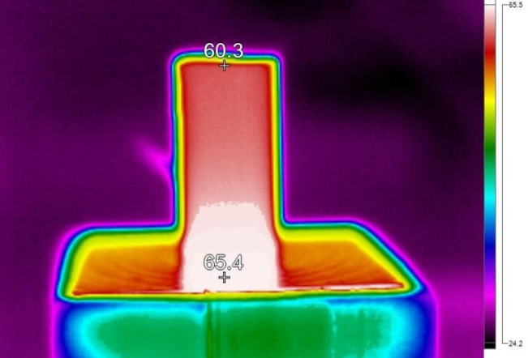
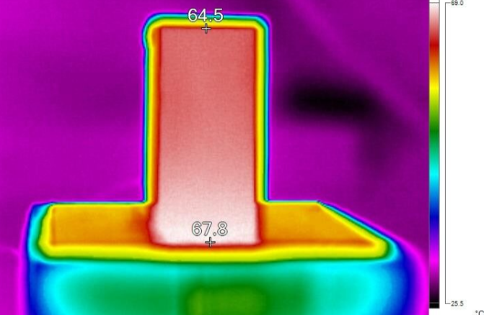
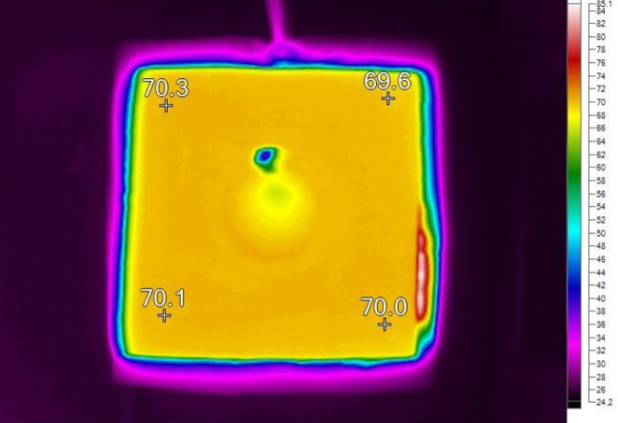
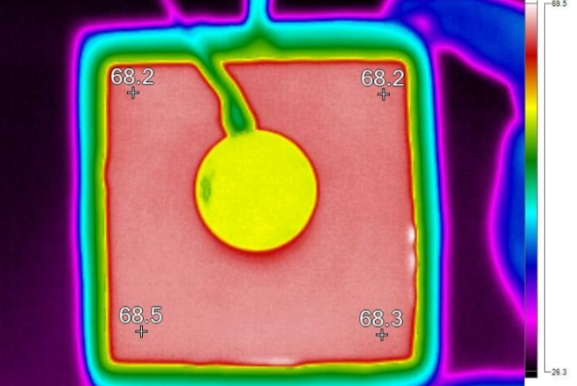
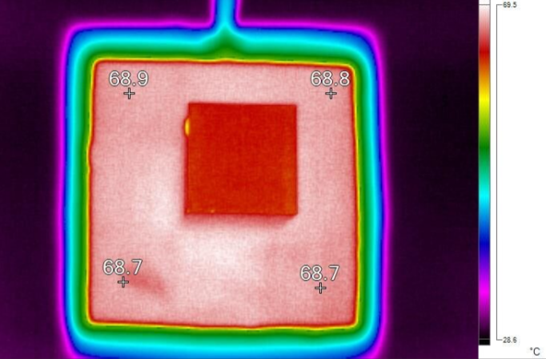
Results & Overview

Slide 15

Preliminary Analysis: Flat Plate
$$Re_{L}=\frac{u_{air}L_{c}}{v_{air}}=22900$$
$$Nu_{L}=.25Re_{L}^{.61}=114$$
$$h=\frac{Nu_{L}k_{air}}{L_{c}}=40.5\frac{W}{m^{2}K}$$

Slide 16

Preliminary Analysis: Rectangular Fin
$$Re_{L}=\frac{u_{air}L_{c}}{v_{air}}=19100$$
$$Nu_{L}=.158{Re}_{L}^{.66}{Pr}_{air}^{\frac{1}{3}}=93.9$$
$$h=\frac{Nu_{L}k_{air}}{L_{c}}=39.9\frac{W}{m^{2}K}$$
$$m=\sqrt{\frac{2h}{k_{aluminum}D}}=3.64$$
$$η_{f}=\frac{\tanh\left(mL_{c}\right)}{mL_{c}}=.983$$

Slide 17

Preliminary Analysis: Cylindrical Fin
$$Re_{D}=\frac{u_{air}D}{v_{air}}=17200$$
$$Nu_{D}=.193{Re}_{D}^{.618}{Pr}_{air}^{\frac{1}{3}}=71.0$$
$$h=\frac{Nu_{D}k_{air}}{D}=33.6\frac{W}{m^{2}K}$$
$$m=\sqrt{\frac{4h}{k_{aluminum}D}}=3.64$$
$$L_{c}=L+\frac{D}{4}=.0572 m$$
$$η_{f}=\frac{\tanh\left(mL_{c}\right)}{mL_{c}}=.976$$

Slide 18

Preliminary Analysis: Conical Fin
$$Re_{D}=\int_{0}^{L}{\frac{u_{air}D(y)}{v_{air}}}dy=7640$$
$$Nu_{D}=.193{Re}_{D}^{.618}{Pr}_{air}^{\frac{1}{3}}=71.0$$
$$h=\frac{Nu_{D}k_{air}}{D}=45.74\frac{W}{m^{2}K}$$
$$m=\sqrt{\frac{4h}{k_{aluminum}D}}=5.51$$
$$η_{f}=\frac{2}{mL}\frac{I_{2}(2mL)}{I_{1}(2mL)}=.997$$

Slide 19
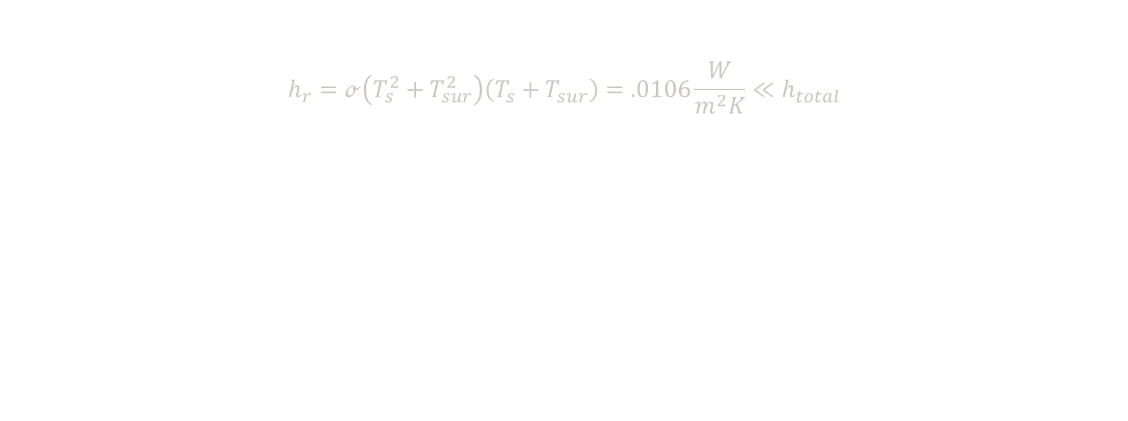
Preliminary Analysis: Radiation
$$h_{r}=ℴ\left(T_{s}^{2}+T_{sur}^{2}\right)\left(T_{s}+T_{sur}\right)=.0106\frac{W}{m^{2}K}≪h_{total}$$

Slide 20
Preliminary Analysis: Summary
Configuration | Re_{Lc} | Nu_{Lc} | h (W/m²K) | m (-) | Fin Efficiency
Flat Plate | 22900 | 114 | 40.5 | - | -
Rectangular | 19100 | 93.9 | 39.9 | 3.64 | 0.983
Cylindrical | 17200 | 71.0 | 33.6 | 4.72 | 0.976
Conical | 7640 | 43.0 | 45.7 | 5.51 | 0.997
Radiation confirmed to be negligible, matching our assumption

Slide 21
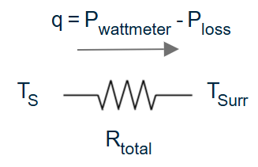
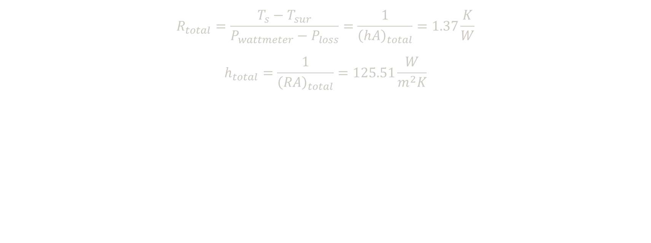
Experimental Analysis: Flat Plate
$$R_{total}=\frac{T_{s}−T_{sur}}{P_{wattmeter}−P_{loss}}=\frac{1}{{\left(hA\right)}_{total}}=1.37\frac{K}{W}$$
$$h_{total}=\frac{1}{{\left(RA\right)}_{total}}=125.51\frac{W}{m^{2}K}$$

Slide 22
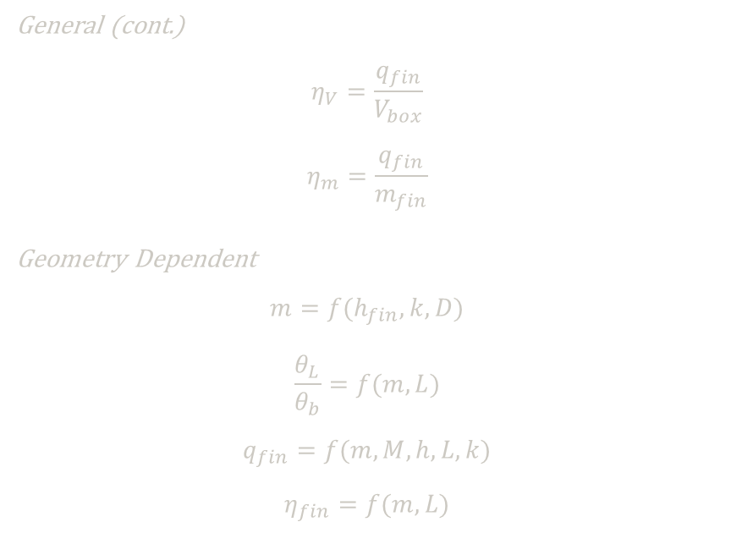
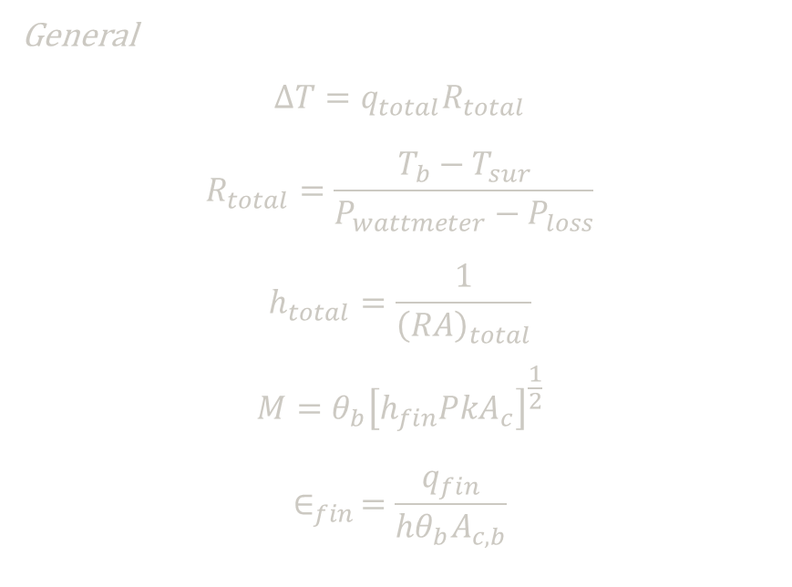
Experimental Analysis: Fin Procedure
General
$$∆T=q_{total}R_{total}$$
$$R_{total}=\frac{T_{b}−T_{sur}}{P_{wattmeter}−P_{loss}}$$
$$h_{total}=\frac{1}{{\left(RA\right)}_{total}}$$
$$M=θ_{b}{\left[h_{fin}PkA_{c}\right]}^{\frac{1}{2}}$$
$$∈_{fin }=\frac{q_{fin}}{hθ_{b}A_{c,b}}$$
General (cont.)
$$η_{V}=\frac{q_{fin}}{V_{box}}$$
$$η_{m}=\frac{q_{fin}}{m_{fin}}$$
Geometry Dependent
$$m=f(h_{fin},k,D)$$
$$\frac{θ_{L}}{θ_{b}}=f(m,L)$$
$$q_{fin}=f(m,M,h,L,k)$$
$$η_{fin}=f(m,L)$$

Slide 23
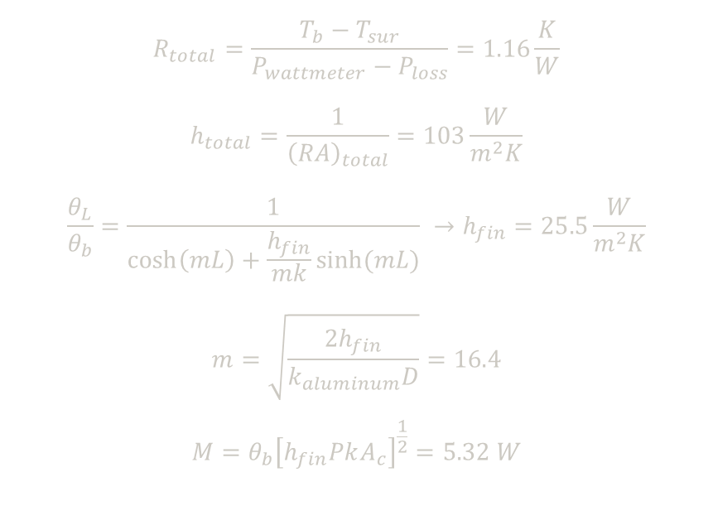
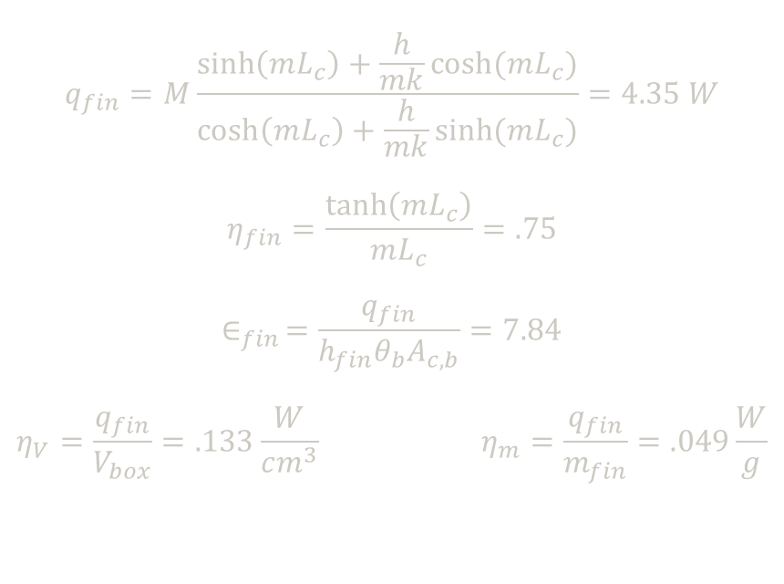
Experimental Analysis: Rectangular Fin
$$R_{total}=\frac{T_{b}−T_{sur}}{P_{wattmeter}−P_{loss}}=1.16\frac{K}{W}$$
$$h_{total}=\frac{1}{{\left(RA\right)}_{total}}=103\frac{W}{m^{2}K}$$
$$\frac{θ_{L}}{θ_{b}}=\frac{1}{\cosh\left(mL\right)+\frac{h_{fin}}{mk}sinh⁡(mL)} →h_{fin}=25.5\frac{W}{m^{2}K}$$
$$m=\sqrt{\frac{2h_{fin}}{k_{aluminum}D}}=16.4$$
$$M=θ_{b}{\left[h_{fin}PkA_{c}\right]}^{\frac{1}{2}}=5.32 W$$
$$q_{fin}=M\frac{\sinh\left(mL_{c}\right)+\frac{h}{mk}cosh⁡(mL_{c})}{\cosh\left(mL_{c}\right)+\frac{h}{mk}sinh⁡(mL_{c})}=4.35 W$$
$$η_{fin}=\frac{\tanh\left(mL_{c}\right)}{mL_{c}}=.75$$
$$∈_{fin }=\frac{q_{fin}}{h_{fin}θ_{b}A_{c,b}}=7.84$$
$$η_{V}=\frac{q_{fin}}{V_{box}}=.133\frac{W}{cm^{3}} η_{m}=\frac{q_{fin}}{m_{fin}}=.049\frac{W}{g}$$
Cylindrical fin has similar equations, but with a different m equation

Slide 24
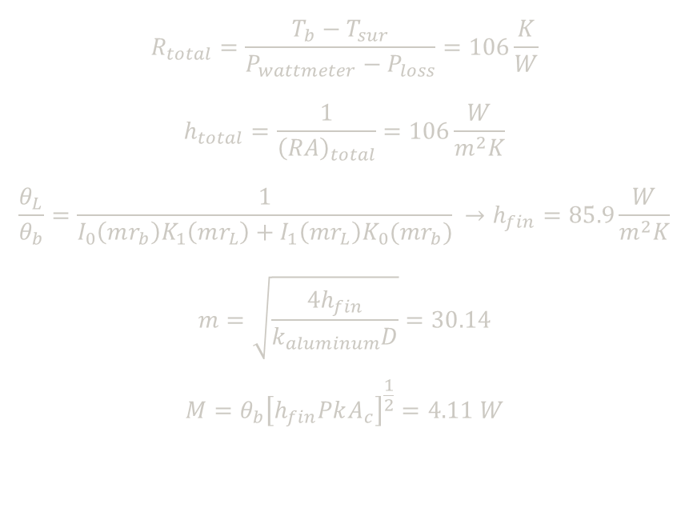
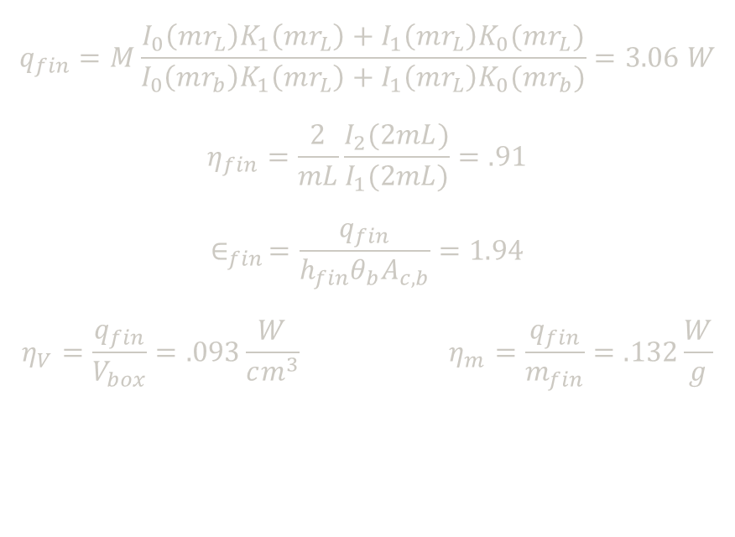
Experimental Analysis: Conical Fin
$$R_{total}=\frac{T_{b}−T_{sur}}{P_{wattmeter}−P_{loss}}=106\frac{K}{W}$$
$$h_{total}=\frac{1}{{\left(RA\right)}_{total}}=106\frac{W}{m^{2}K}$$
$$\frac{θ_{L}}{θ_{b}}=\frac{1}{I_{0}\left(mr_{b}\right)K_{1}\left(mr_{L}\right)+I_{1}\left(mr_{L}\right)K_{0}(mr_{b})} →h_{fin}=85.9\frac{W}{m^{2}K}$$
$$m=\sqrt{\frac{4h_{fin}}{k_{aluminum}D}}=30.14$$
$$M=θ_{b}{\left[h_{fin}PkA_{c}\right]}^{\frac{1}{2}}=4.11 W$$
$$q_{fin}=M\frac{I_{0}\left(mr_{L}\right)K_{1}\left(mr_{L}\right)+I_{1}\left(mr_{L}\right)K_{0}(mr_{L})}{I_{0}\left(mr_{b}\right)K_{1}\left(mr_{L}\right)+I_{1}\left(mr_{L}\right)K_{0}(mr_{b})}=3.06 W$$
$$η_{fin}=\frac{2}{mL}\frac{I_{2}(2mL)}{I_{1}(2mL)}=.91$$
$$∈_{fin }=\frac{q_{fin}}{h_{fin}θ_{b}A_{c,b}}=1.94$$
$$η_{V}=\frac{q_{fin}}{V_{box}}=.093\frac{W}{cm^{3}} η_{m}=\frac{q_{fin}}{m_{fin}}=.132\frac{W}{g}$$
Cylindrical has same m equation as conical

Slide 25
Experimental Analysis: Summary
Configuration | Trial | R_{tot} (K/W) | h_{tot} (W/m²K) | h_{fin} (W/m²K) | m (-) | q_{f} (W)
Flat Plate | 1 | 1.33 | 130 | - | - | -
 | 2 | 1.37 | 126 | - | - | -
Rectangular | 1 | 1.16 | 103 | 25.5 | 16.4 | 4.35
 | 2 | 1.08 | 110 | 21.1 | 14.9 | 3.43
Cylindrical | 1 | 1.10 | 92.1 | 15.0 | 12.6 | 2.03
 | 2 | 1.05 | 96.8 | 33.2 | 18.7 | 3.50
Conical | 1 | 1.37 | 99.0 | 85.9 | 30.1 | 3.28
 | 2 | 1.27 | 106 | 85.9 | 30.1 | 3.06

Slide 26
Experimental Analysis: Summary
Configuration | Trial | Fin Effectiveness | Fin Efficiency | Volumetric Efficiency (W/m³) | Mass Efficiency (W/kg)
Rectangular | 1 | 7.84 | 0.75 | 0.1326 | 0.049
 | 2 | 8.22 | 0.78 | 0.1047 | 0.039
Cylindrical | 1 | 8.30 | 0.86 | 0.0619 | 0.029
 | 2 | 6.98 | 0.74 | 0.1067 | 0.050
Conical | 1 | 1.94 | 0.91 | 0.1002 | 0.142
 | 2 | 1.94 | 0.91 | 0.0933 | 0.132
Fin effectiveness of >2 is required to justify using fins
  Conical fins are not justifiable

Slide 27
Errors & Improvements
During Experiment:
  Tip thermocouples were taped to fins on side opposing airflow
  Part of the bottom insulation melted
  IR camera & thermocouple readings differed
  Small portions of paint chipped off
Future:
  Embedded tip thermocouples
  More durable insulation material
  Smoother fin & plate surfaces

Slide 28
Conclusions
Configuration | Volumetric Efficiency (W/m³) | Mass Efficiency (W/kg)
Rectangular | 0.133 | 0.049
 | 0.105 | 0.039
Conical | 0.100 | 0.142
 | 0.0933 | 0.132

Slide 29
Questions?

