Slide 1
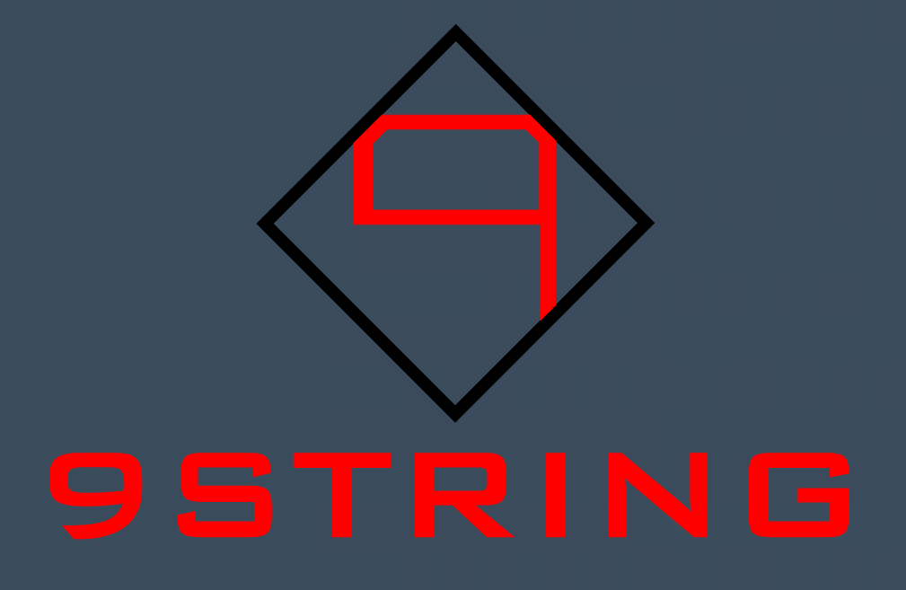
SpineAlign
Posture Correction Device
9 String

Slide 2
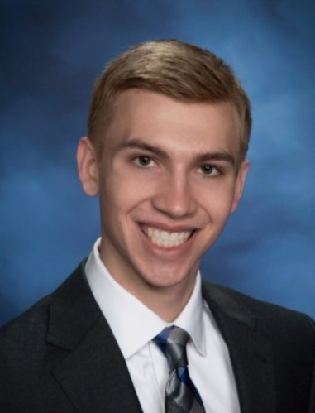
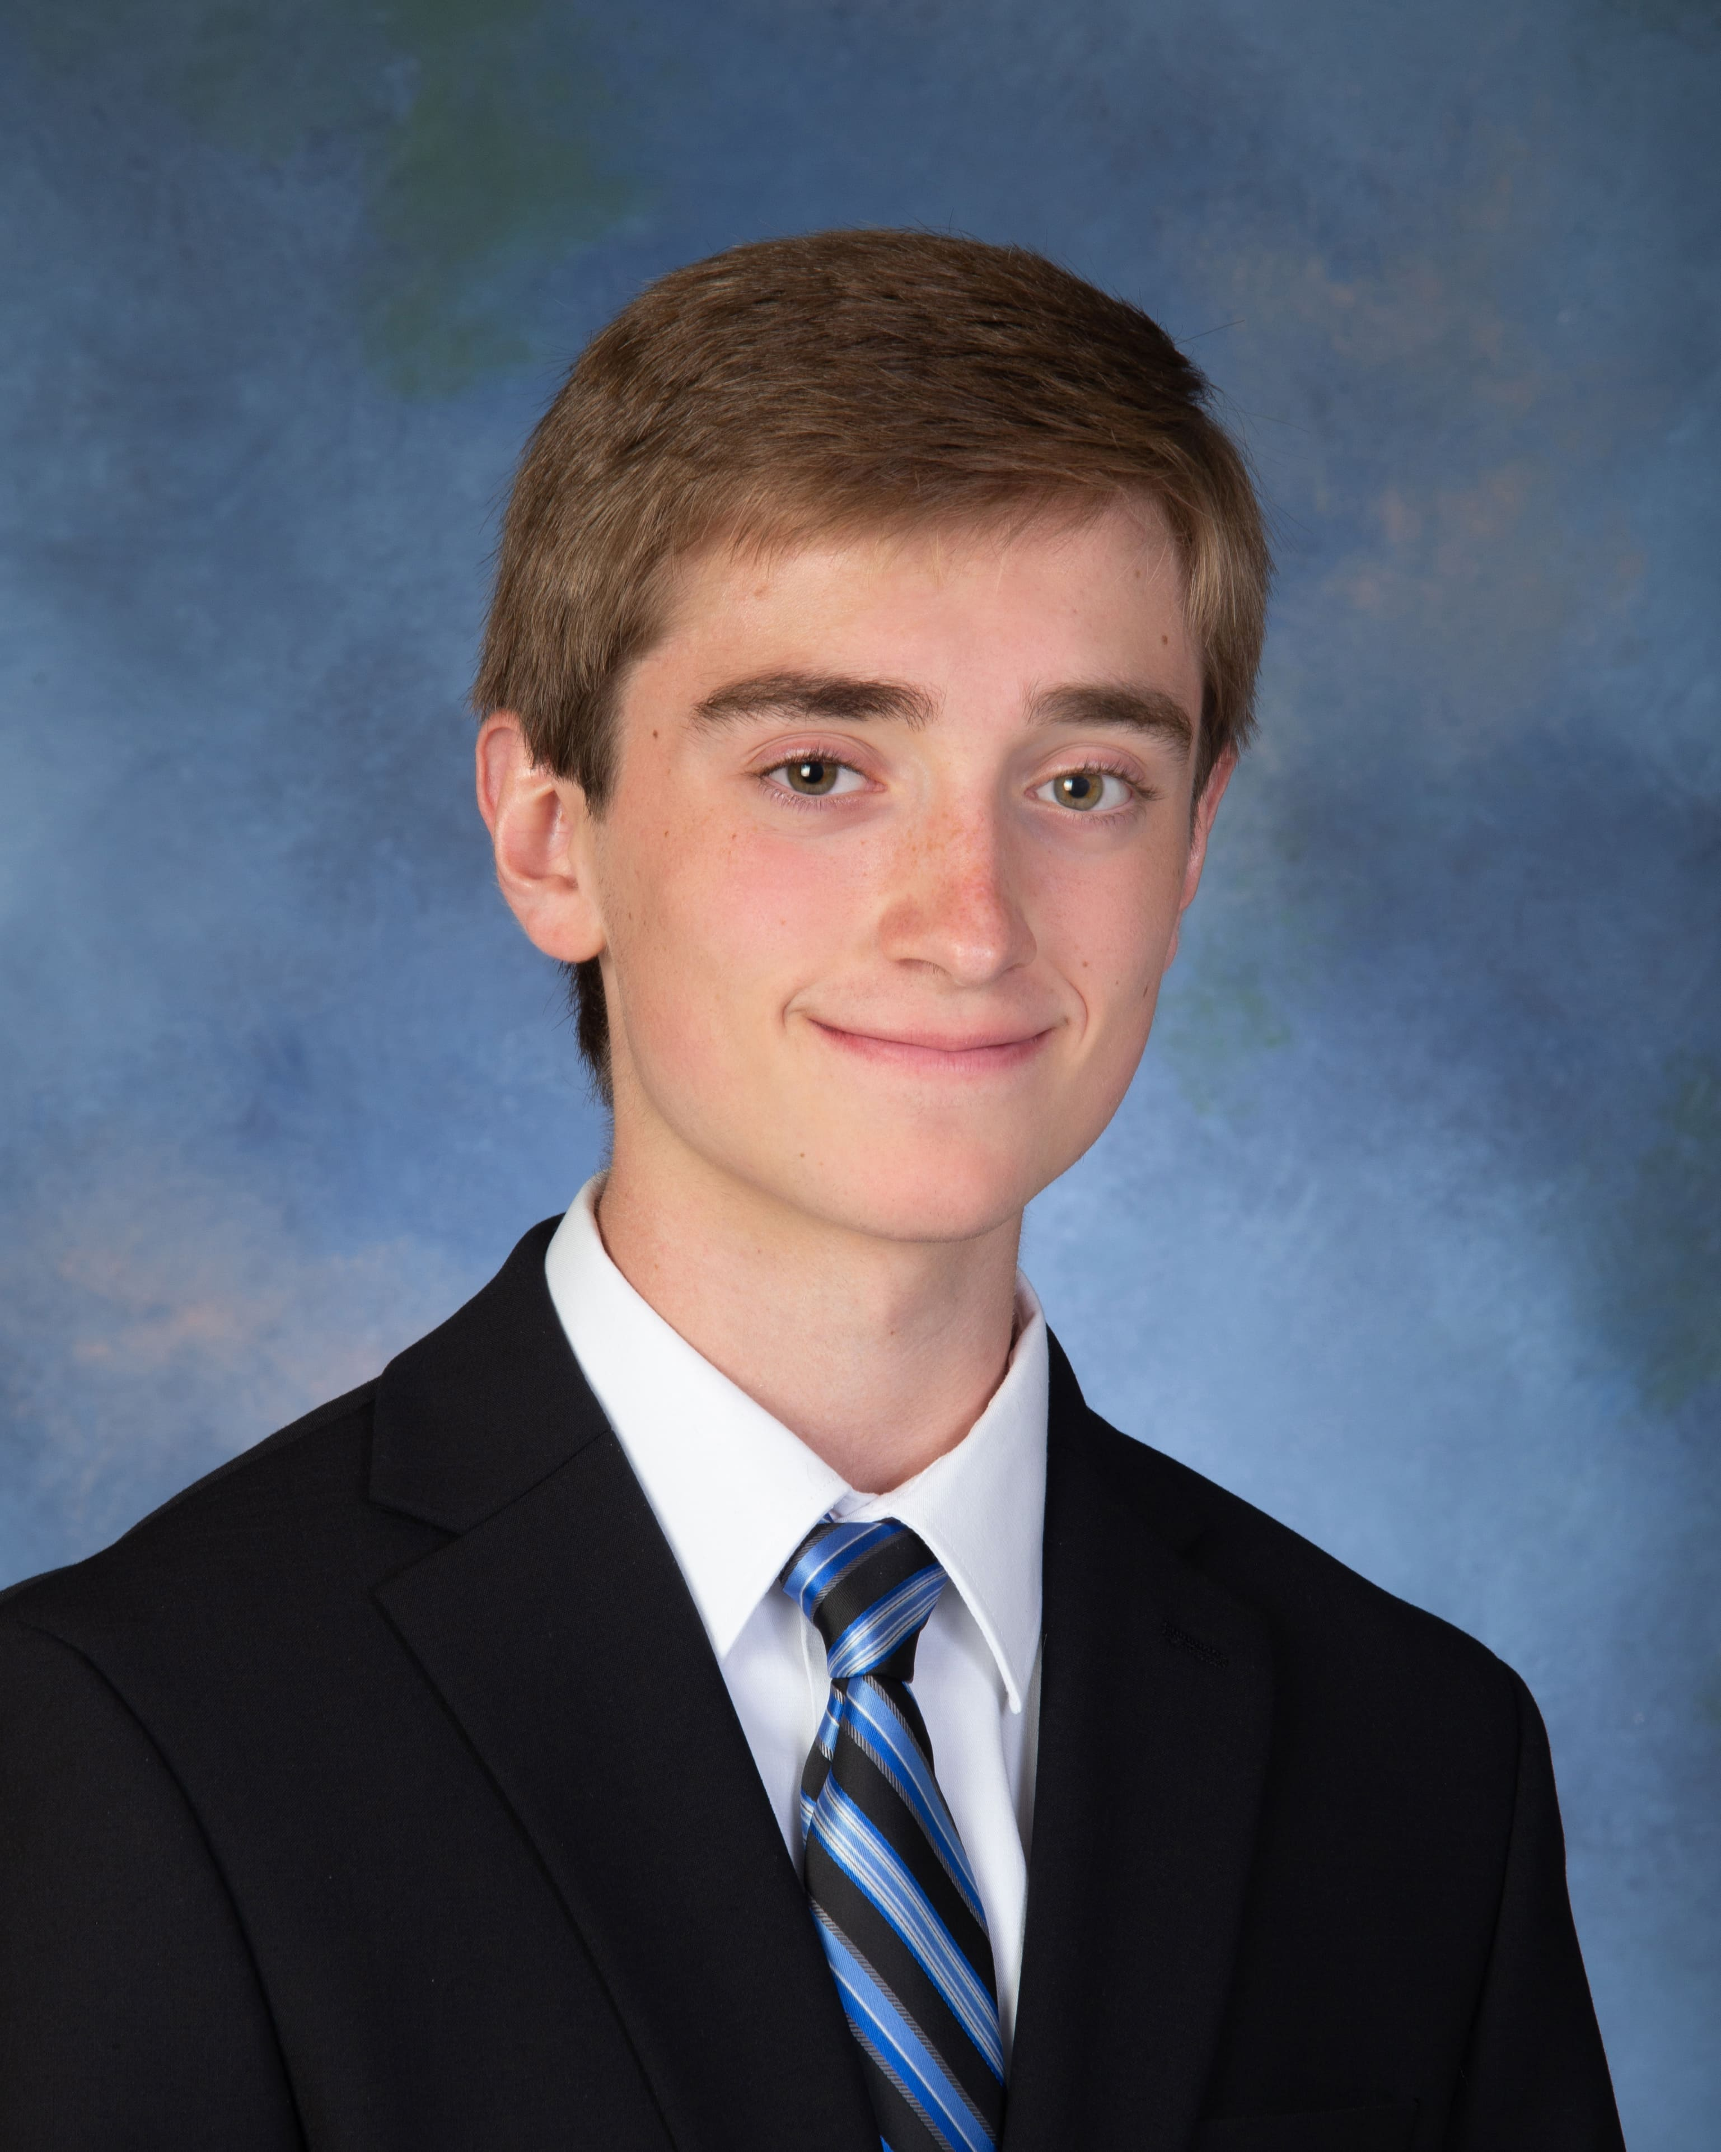

Team Members
Jackson Emerson
David Jakel
Aidan Pierce

Slide 3
Table of Contents
Introduction..................................4
Concept Generation....................9
Operational Description...........12
Bill of Materials.........................20
Assembly Analysis...................23
Benchmark Analysis...............27
Financial Analysis....................30
Conclusion ….............................34

Slide 4
Introduction

Slide 5
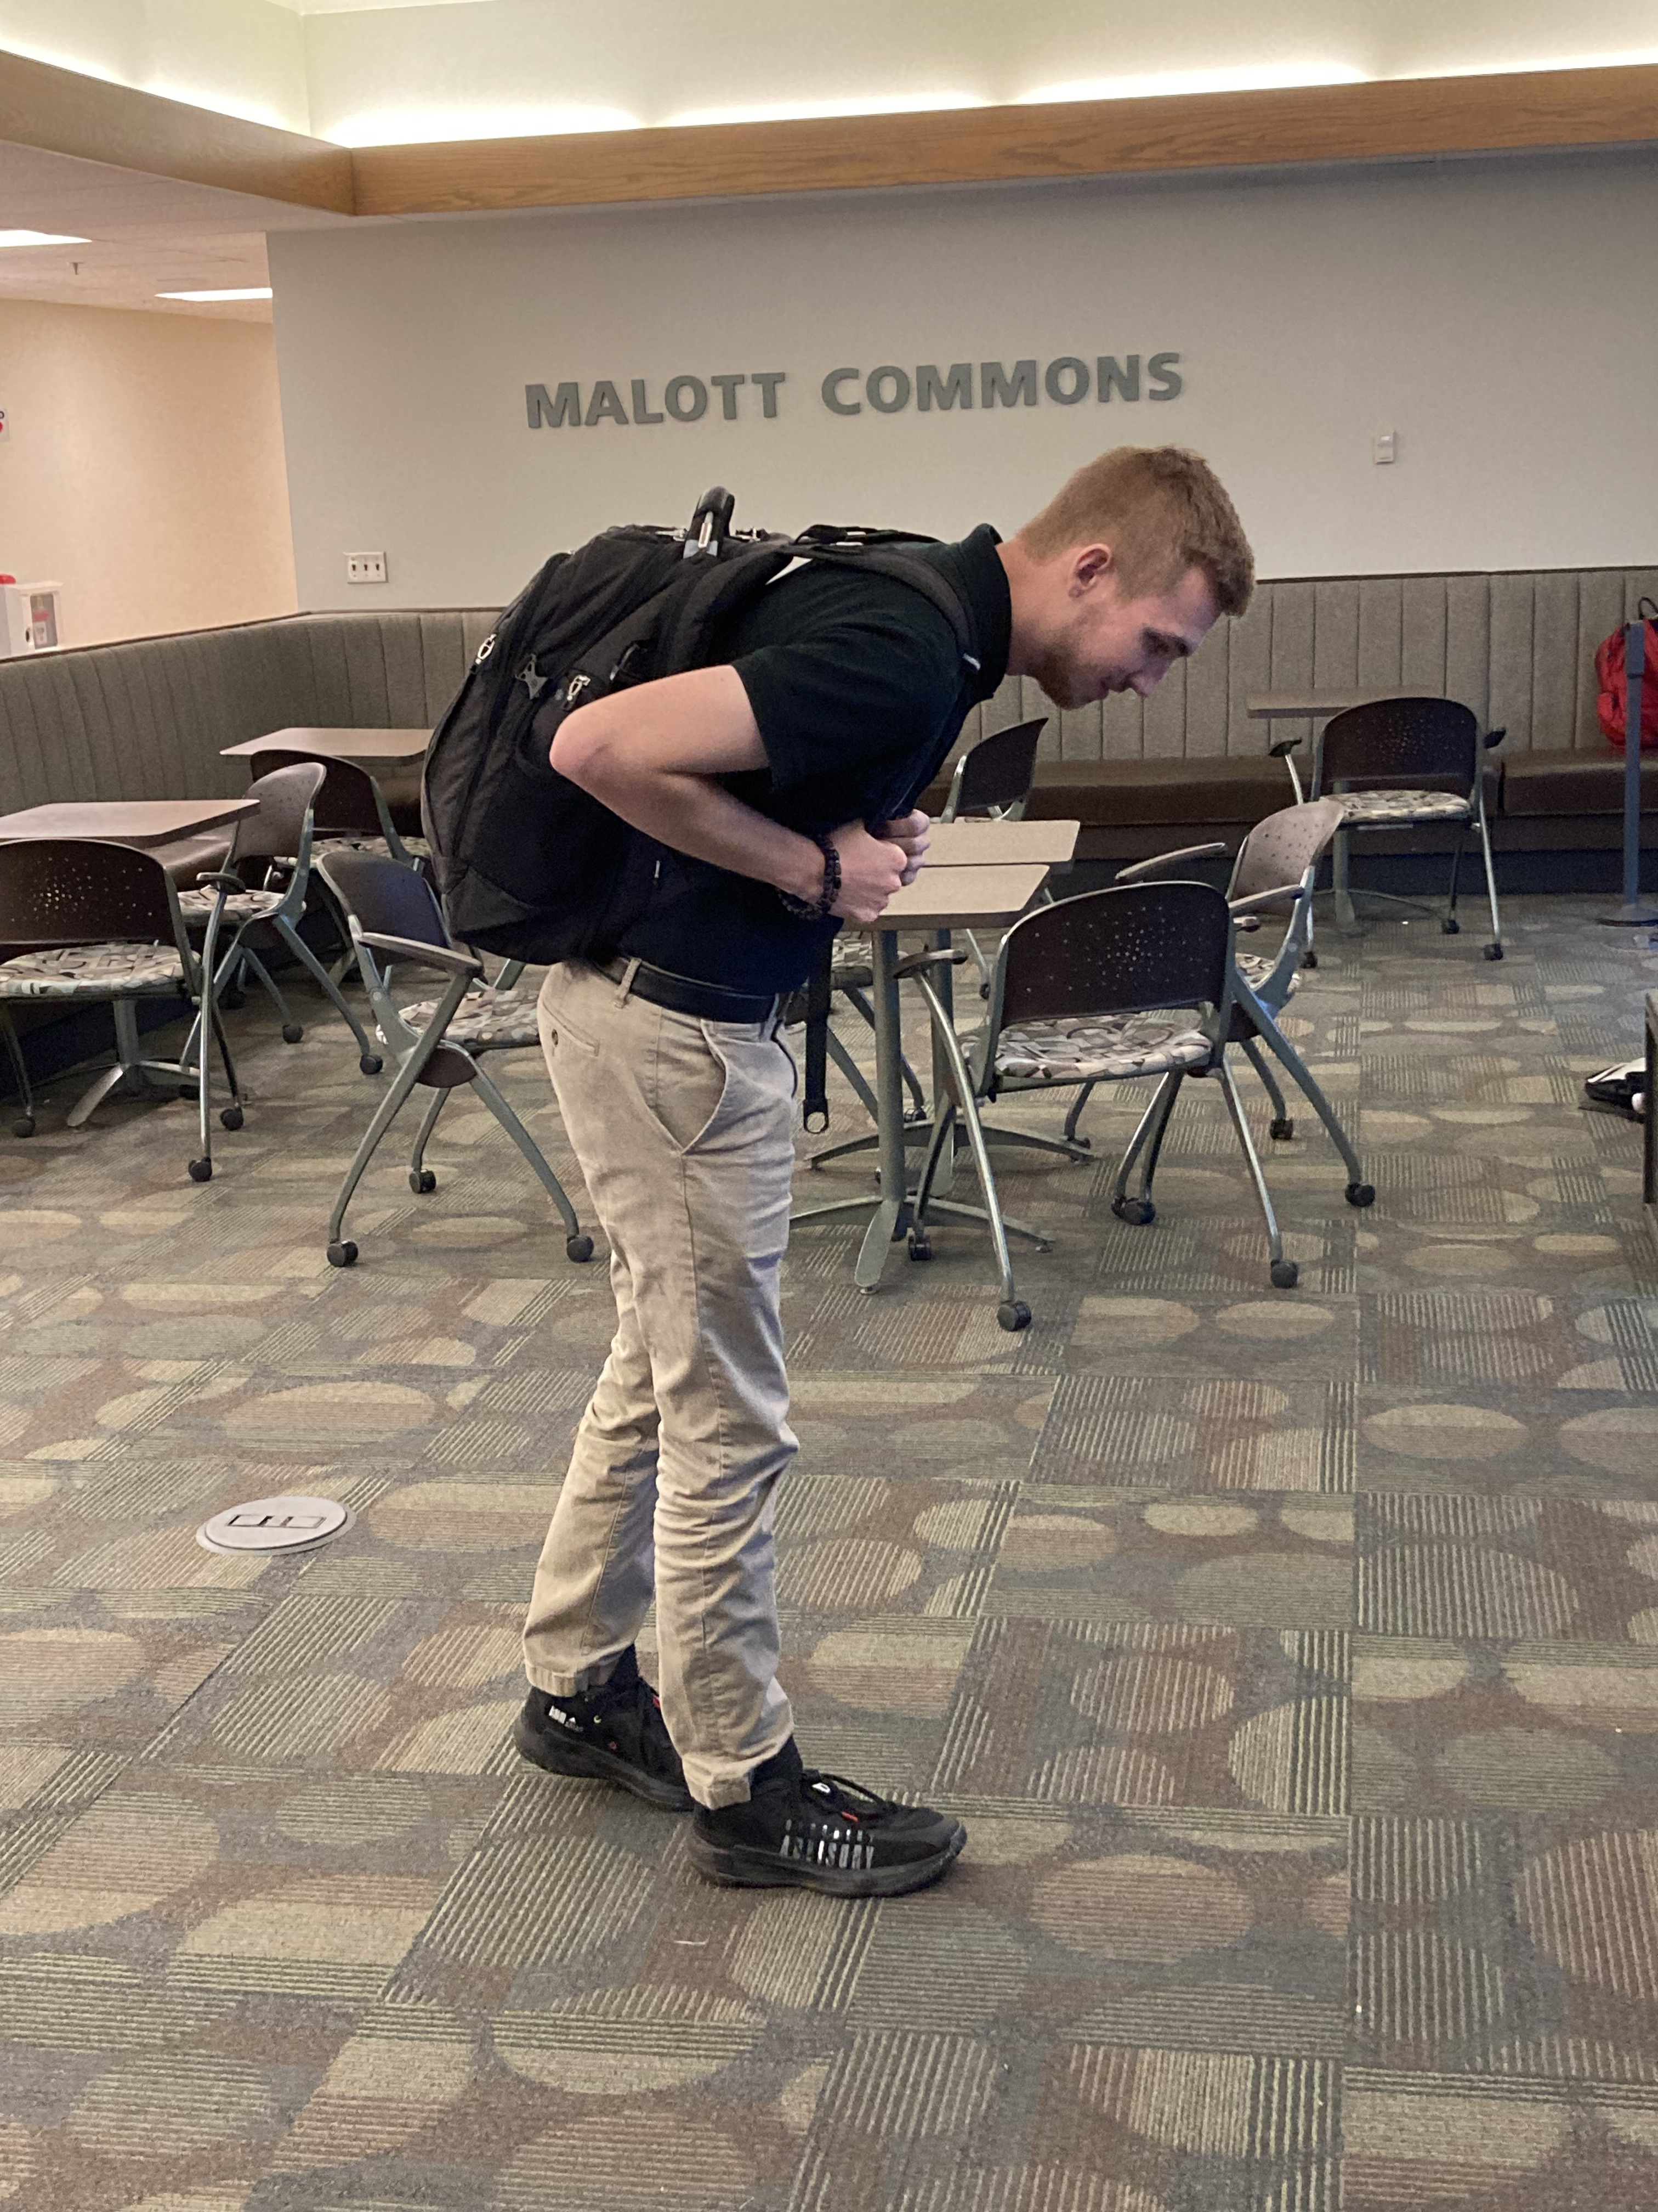
Problem Statement
Identify the cause of poor posture habits and related pain in college students and develop a solution to promote better posture and healthy habits on campus.
How was it selected?
Identified several problems from each member
Selected 3 from the list
Voted for problem – Poor Posture won

Slide 6
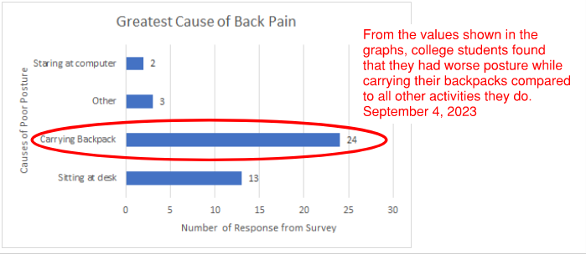
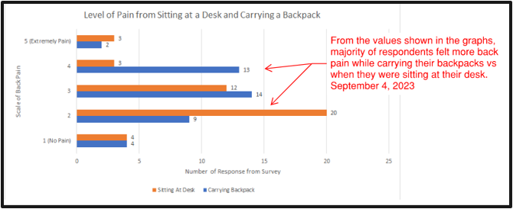
What is the cause of students’ back pain?
Question: “What causes you the greatest back, neck, or shoulder pain on a typical day?”
Sitting at Desk: 31.0%
Carrying Backpack: 57.1%
Question: “On a scale of 1-5, how would you rate your back discomfort when sitting at your desk for extended periods of time and after carrying your backpack for extended periods of time? (5 is extreme pain, 1 is no pain at all)”
Sitting Mean Pain: 2.54
Carrying Backpack Mean Pain: 3.0

Slide 7
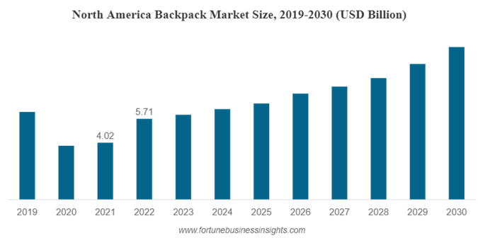
Current Backpack Market Trends
Current market valued ~ $16 billion globally [1]
Market is expected to increase through the next several years
Large market opportunity for both domestic and global
The backpack market will continue to grow for the next few years with a domestic market value of $5.71 billion

Slide 8
Problem Definition
Prolonged poor posture habits can have a larger impact on students’ health and can be chronic if left unaddressed
Identified possible consumer base for this project:
  College students
  High school students
  People who have an intra-city commute
Important characteristics of this project would be:
  The unit cost is affordable to students
  The project encourages better posture
  Able to be used with any backpack, and can be transported

Slide 9
Concept Generation

Slide 10
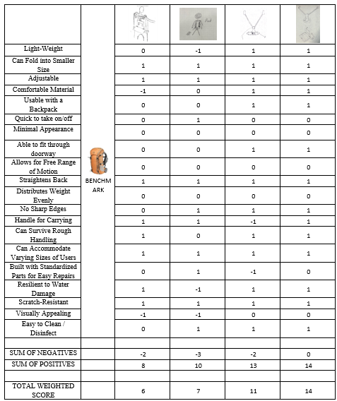
Pugh Decision Matrix
Evaluation of each design
Utilized determine Concept 4
Concept 4 has fewest negatives and highest overall score

Slide 11
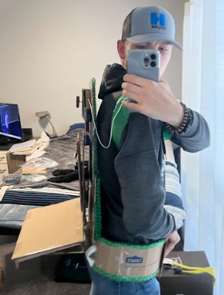
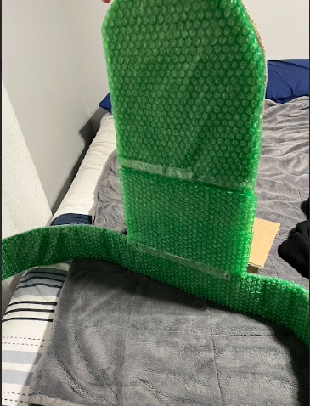
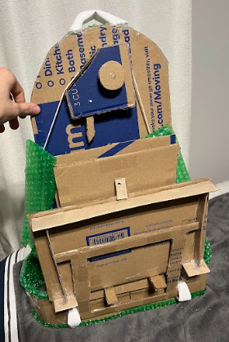
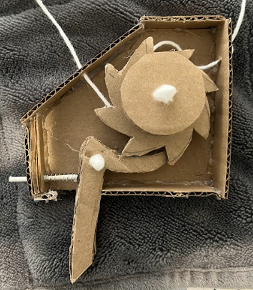
Low-Fidelity Prototype

Slide 12
Operational Description

Slide 13
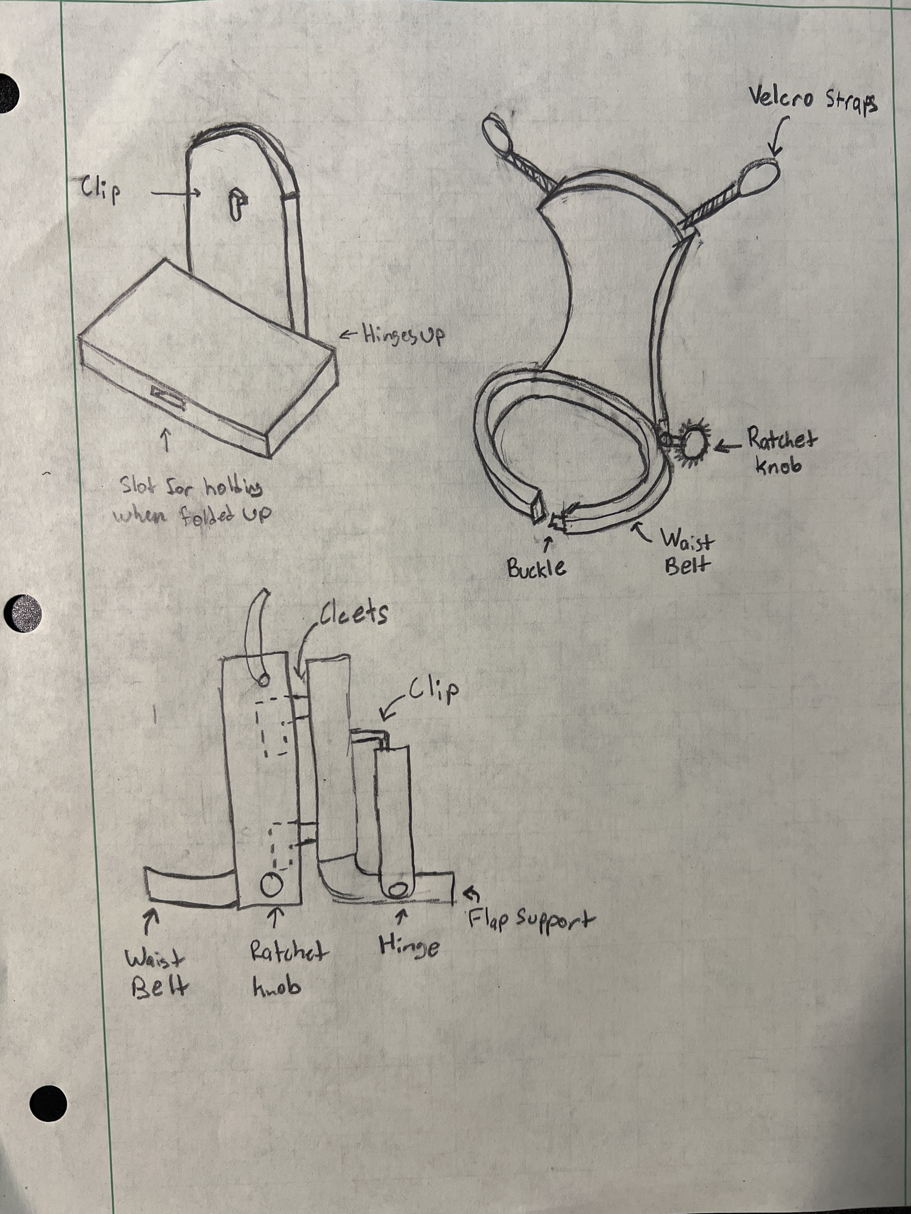
Primary Concept Design Information
2 Part Design
  Posture Correction
  Backpack Assistance
Velcro Adjustable Arm Straps
Ratchet Tightening
Interlocking of Backpack Assistance
Backpack Interlocking
Folding to Narrow Profile
Lightweight
Handle For Carrying

Slide 14
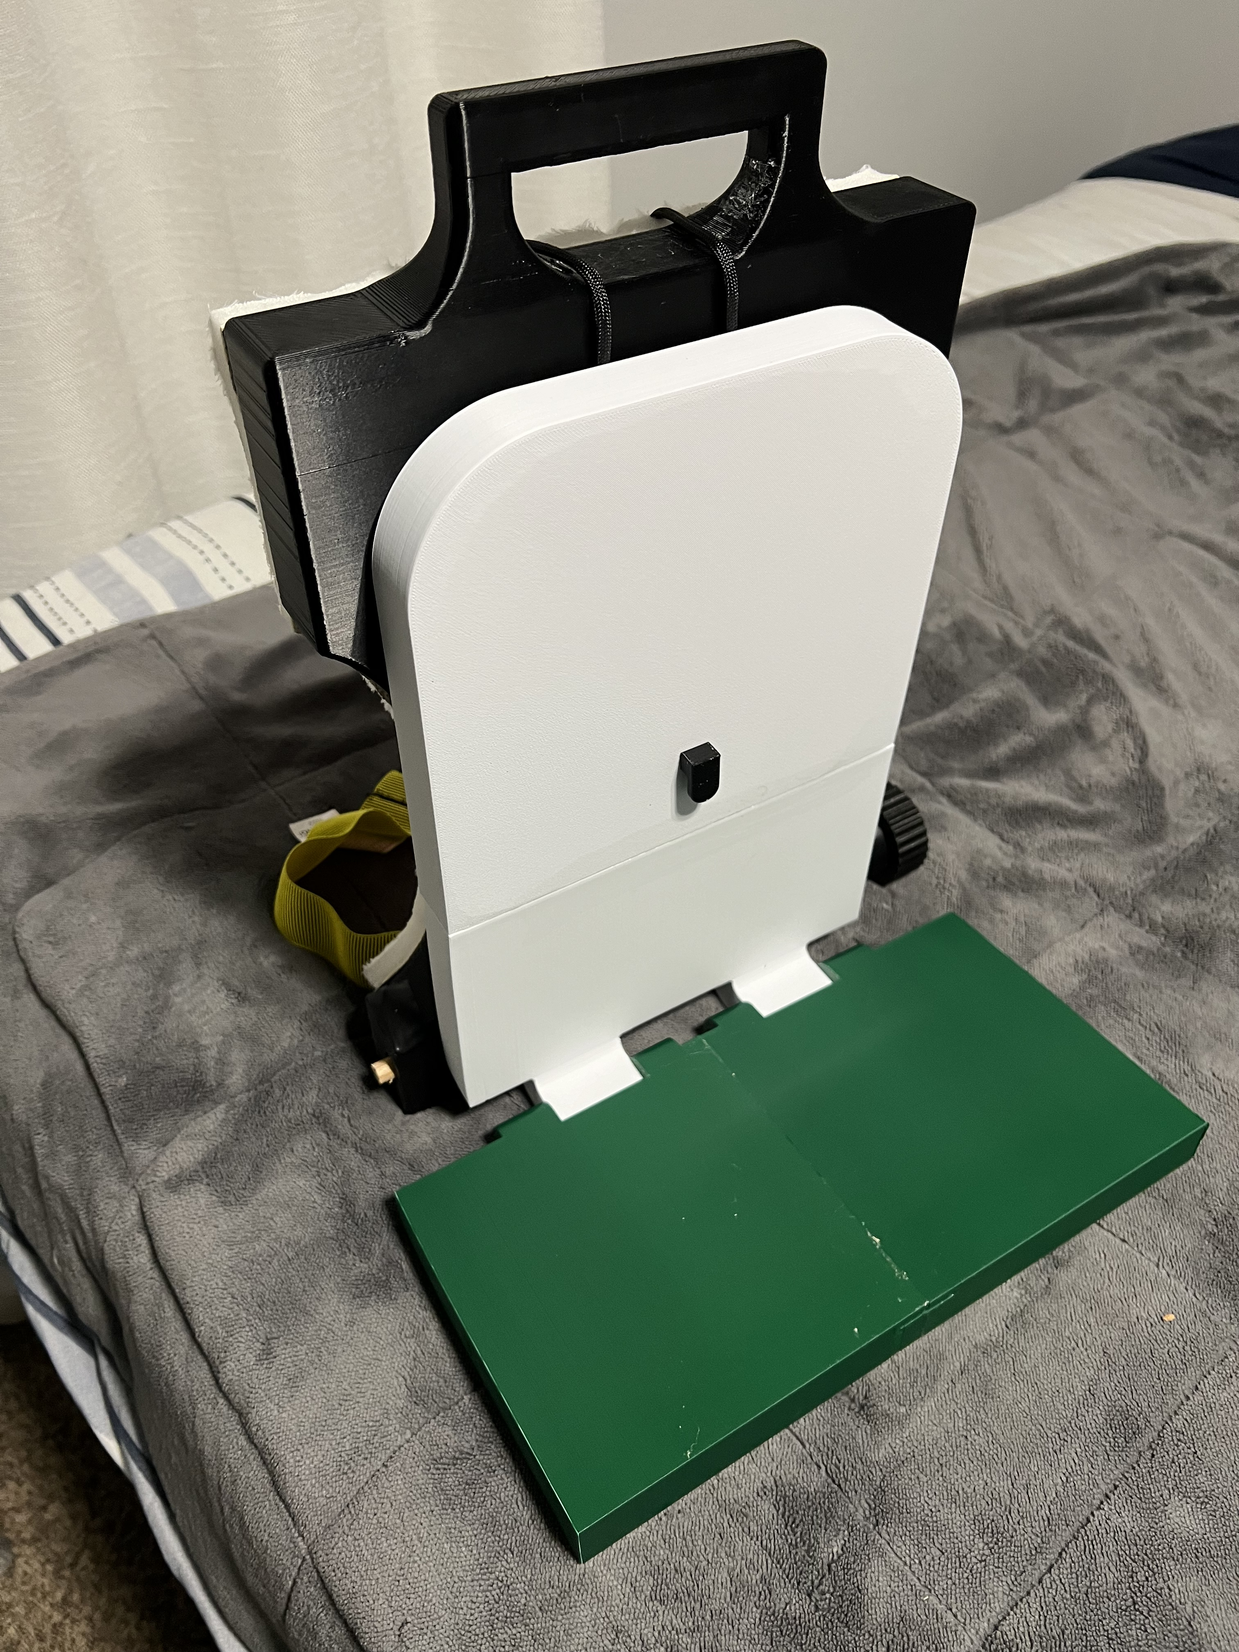
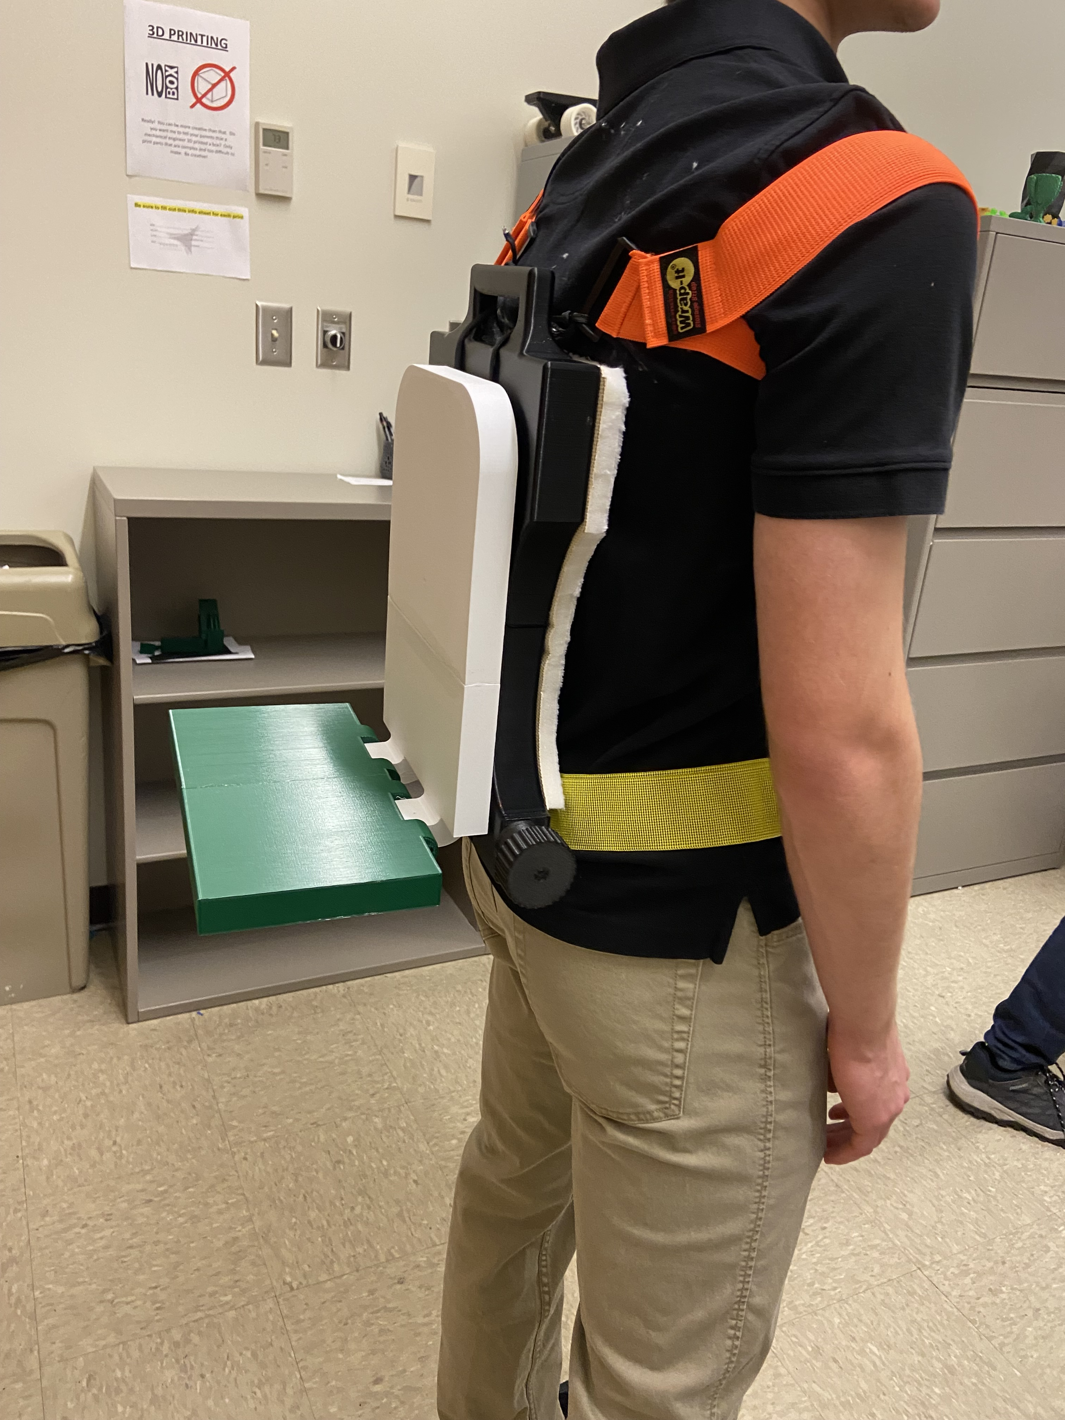
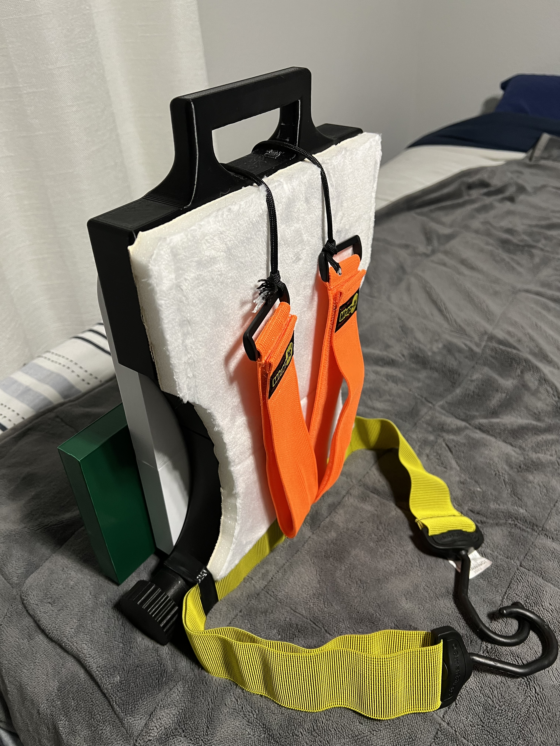
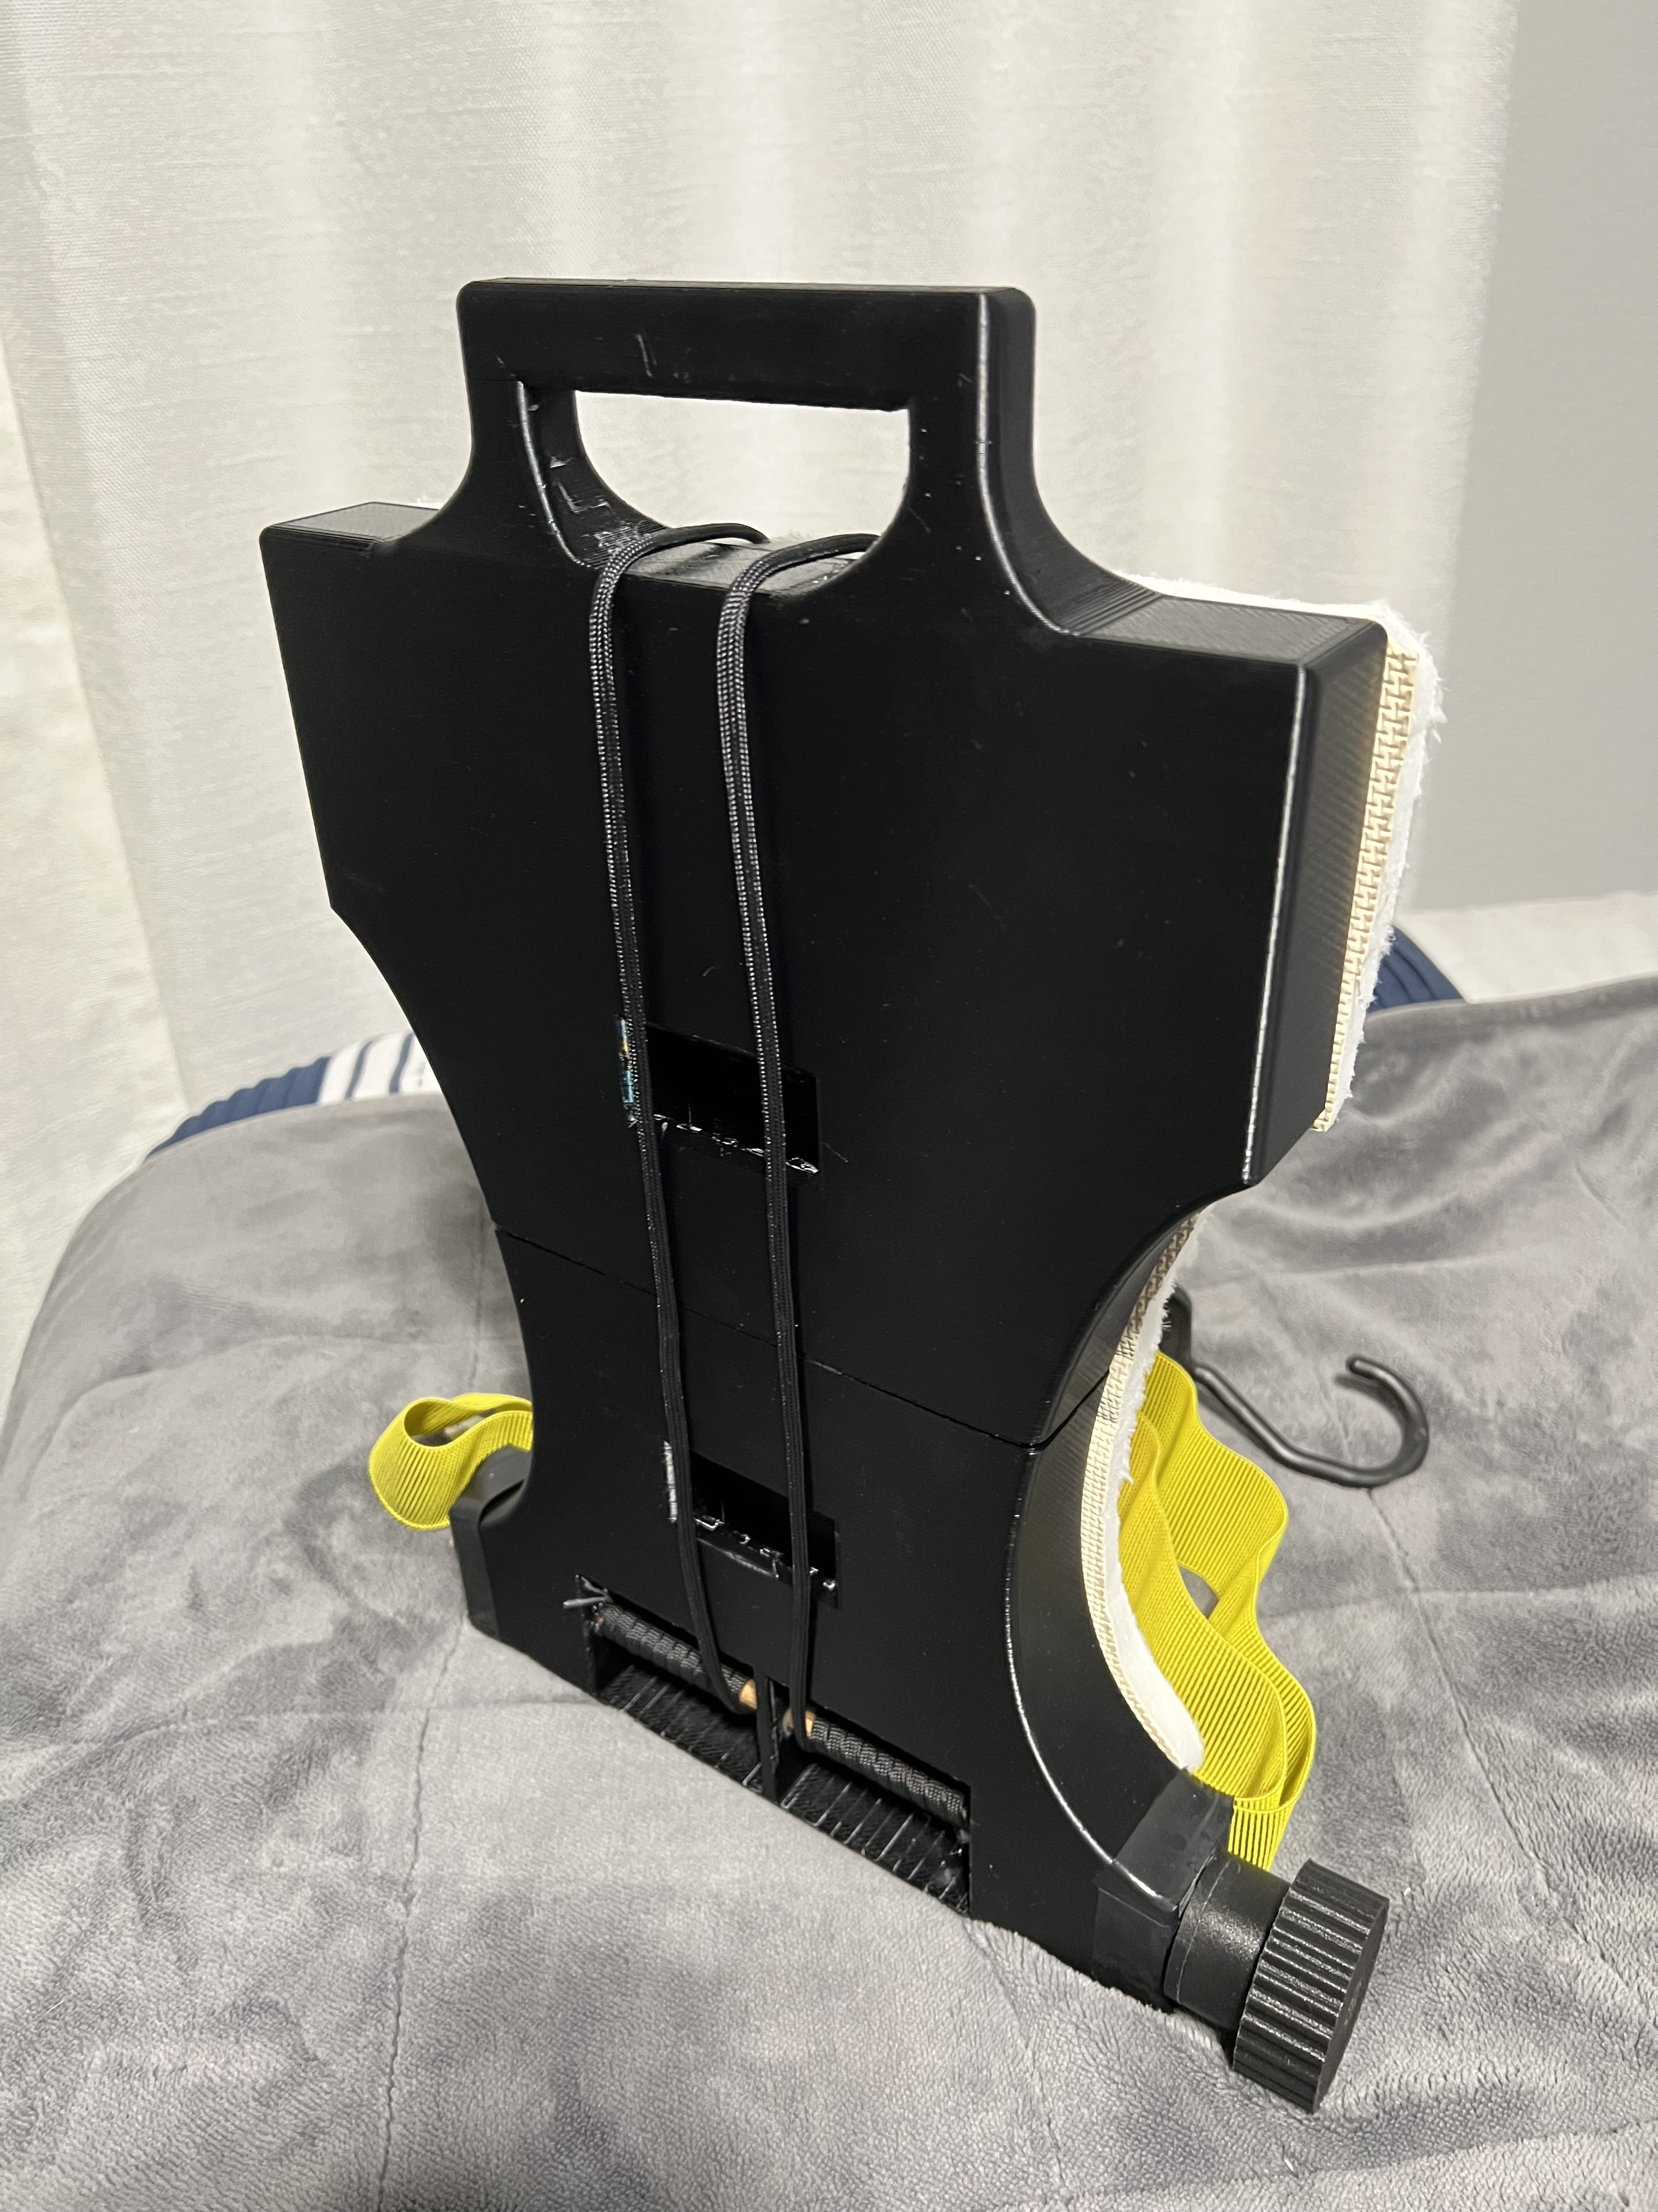
Mid-Fidelity Prototype

Slide 15
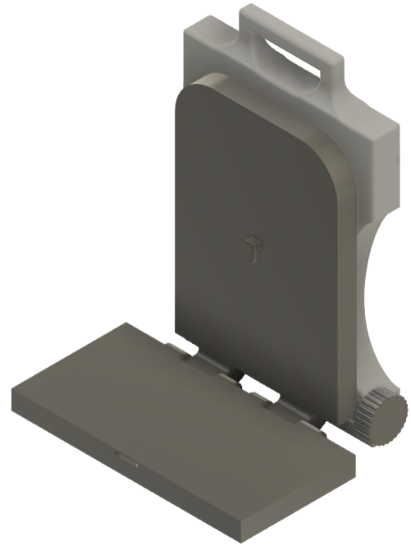
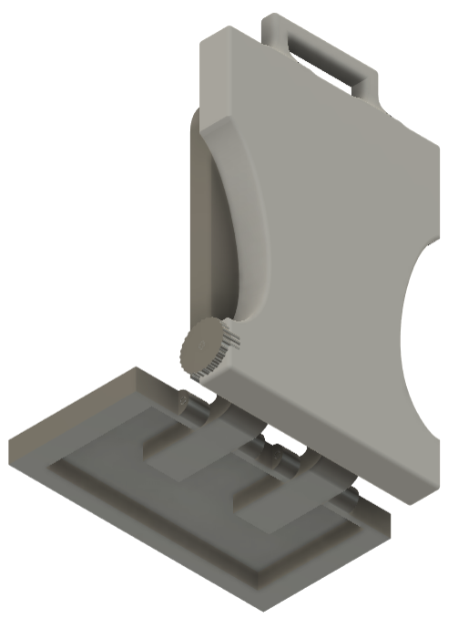
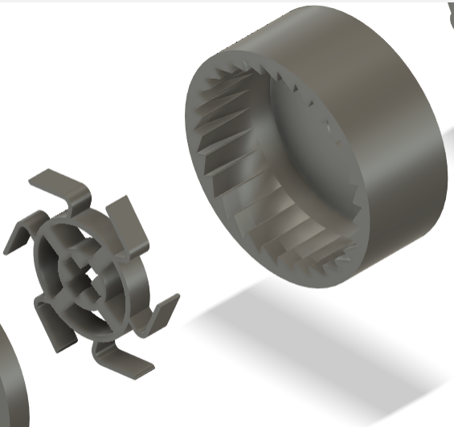
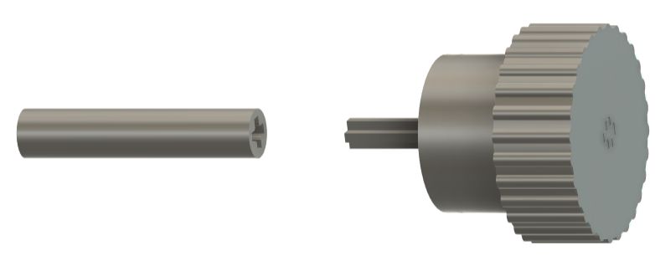
CAD

Slide 16
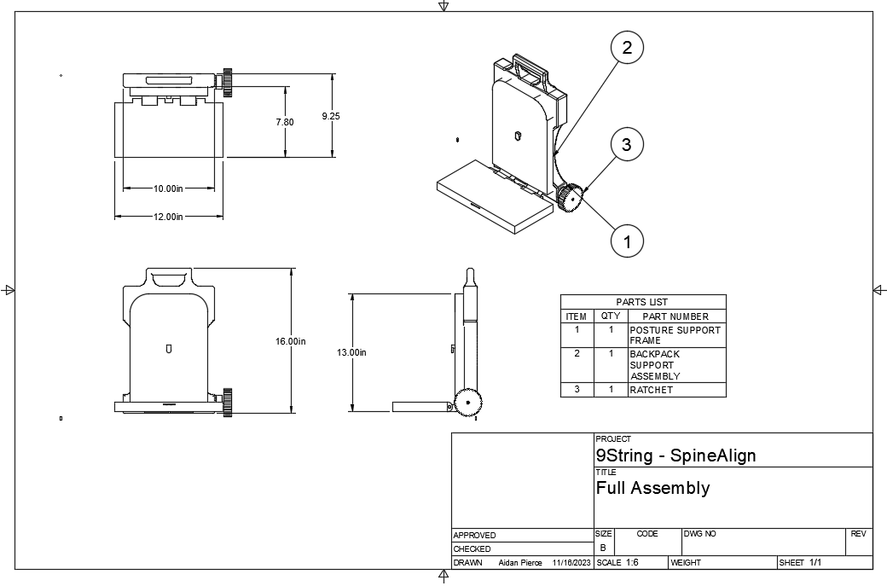
SpineAlign Full Assembly

Slide 17
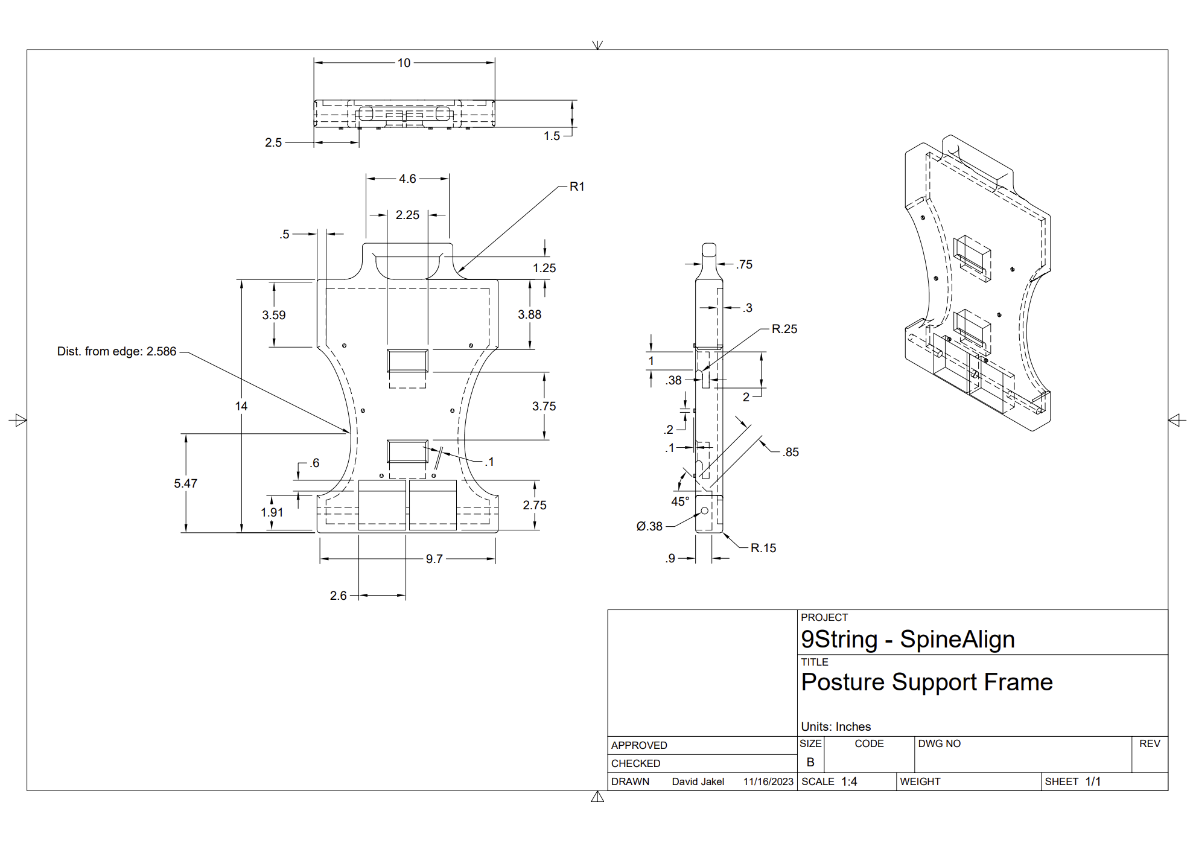
Posture Support Frame

Slide 18
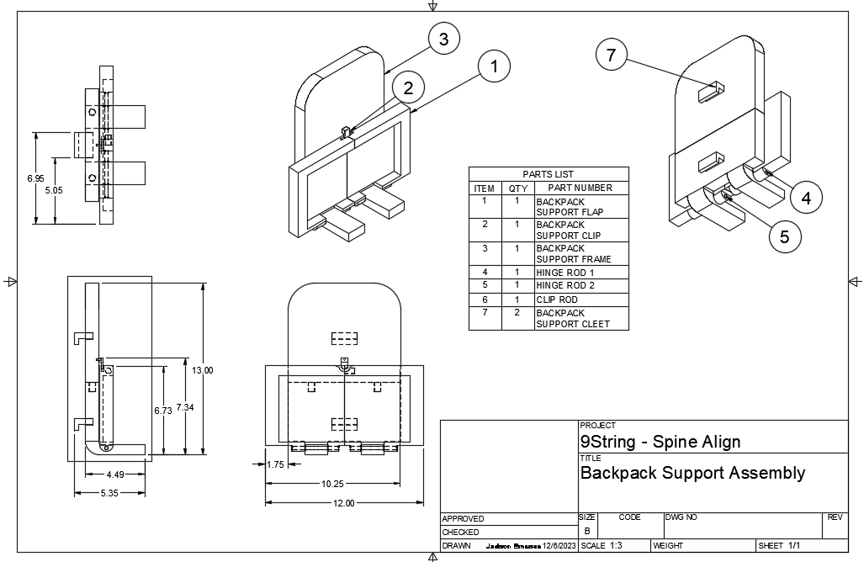
Backpack Support Assembly

Slide 19
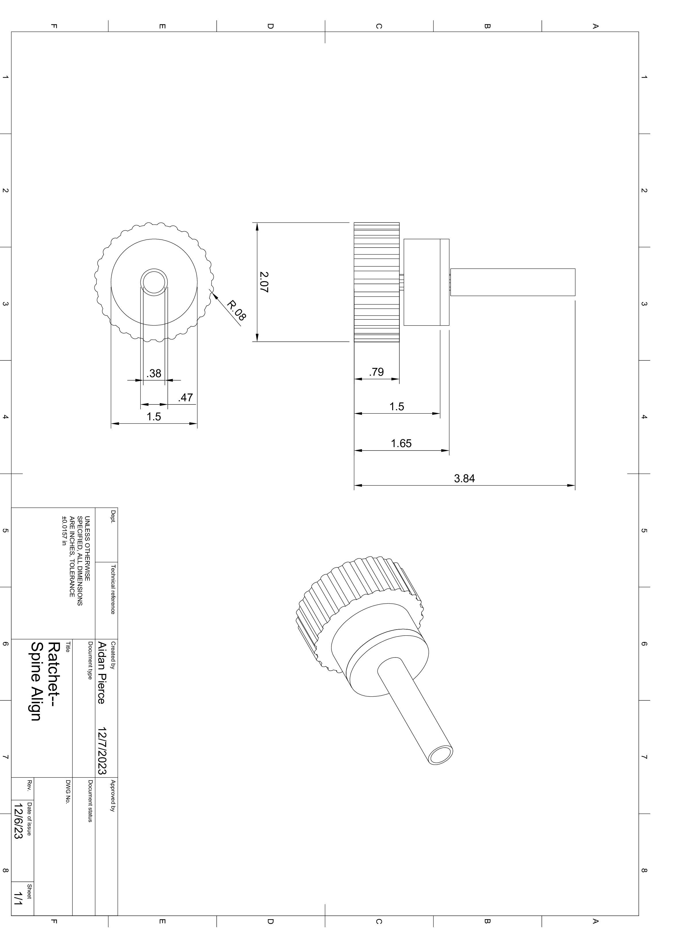
Ratchet Assembly
4
3, not visible
2
1

Slide 20
Bill of Materials

Slide 21
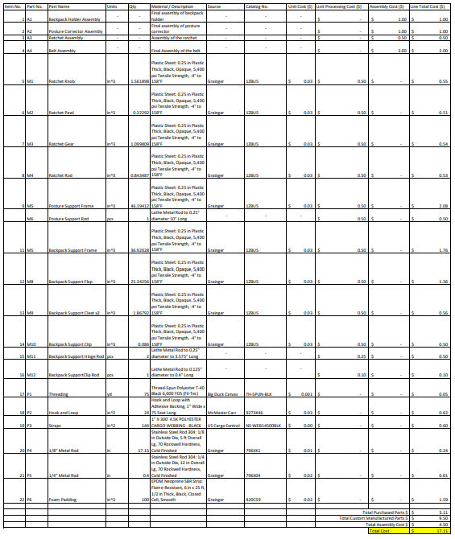
Full Production
Total Cost: $17.11
Purchased parts include straps, metal rods, and foam padding
Injection-molded custom structural plastic components

Slide 22
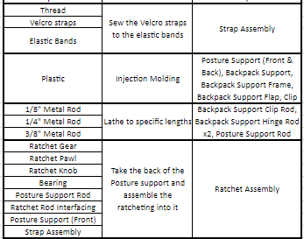
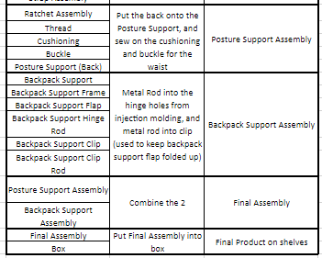
Assembly Process

Slide 23
Assembly Analysis and Tolerance Discussion

Slide 24
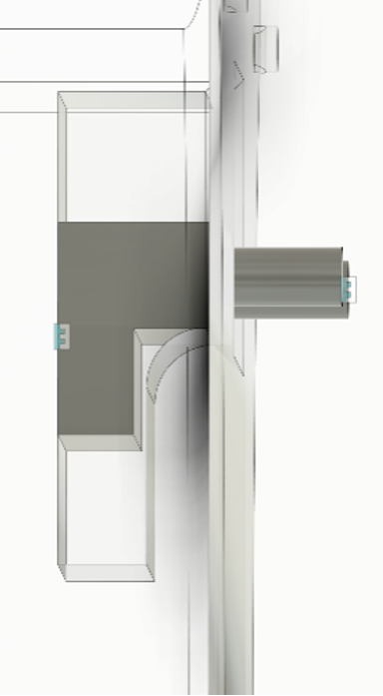
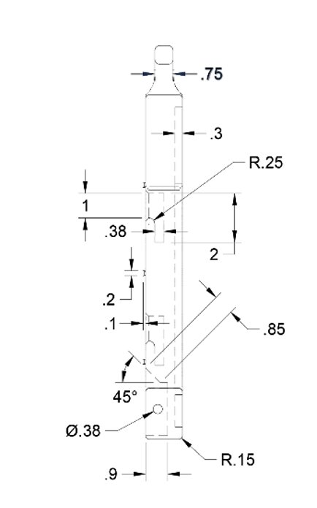
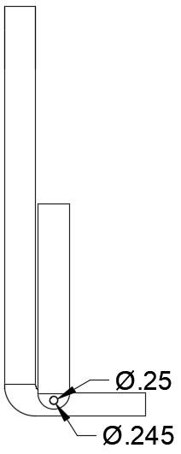
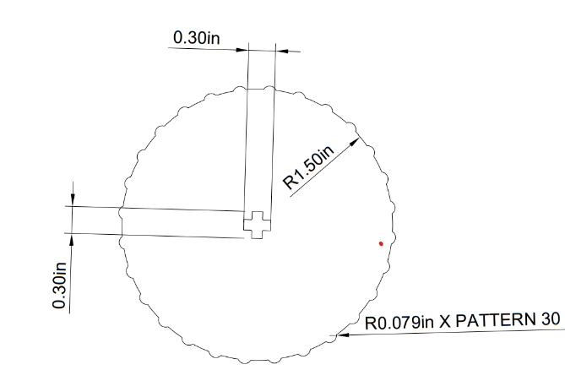
Tolerances
0.055 +/- 0.00707 inches between hook* and slot
0.4 +/- 0.108 inches between cutout and axle
0.005 +0.013/-0.003 inches between rod and backpack support element
*Note: hook and backpack support assembly vertical support are single part in final model

Slide 25
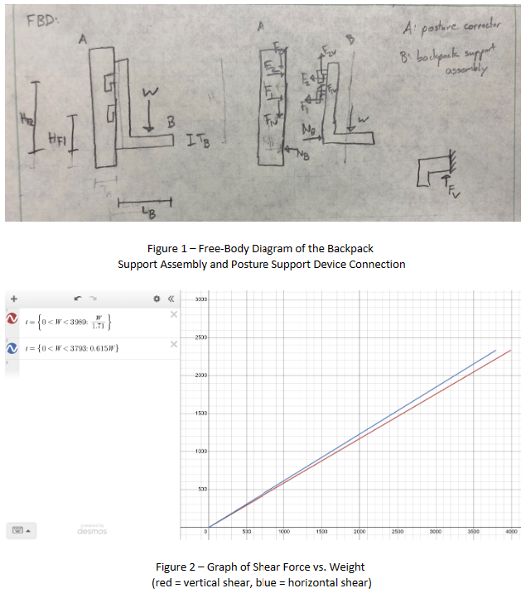
Assembly Analysis 1
Results: Hooks will shear at applied weight of 3793 lbs. of applied force (is not a limiting factor in design)
Assumptions:
  Safety factor of 3
  Replace loading on 2 hooks with single load between hooks
  Constant thickness, width, length
  ABS material (7000 psi yield strength
  No prior induced stress or curvature in the components
  Backpack support assembly and posture corrector are rigid
  Weight of components is negligible in comparison to applied weight
  Environmental factors negligible

Slide 26
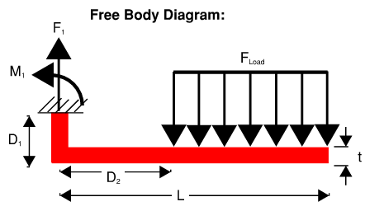
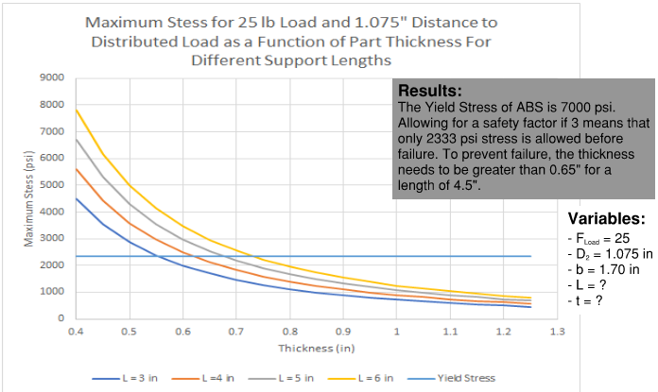
Assembly Analysis 2
Results: Backpack Support Frame Stops must be at least 0.65 inches thick to prevent failure
Assumptions:
  Safety factor of 3
  Replace all loading with a single 25 lb. discrete load at the center
  Treat platform as beam
  Constant thickness, width, length
  ABS material (Young's Modulus of 340,000 psi; yield strength of 7,000 psi)
  Pinned reaction at end and roll reaction at center
  Environmental factors negligible
  No induced stress or curvature

Slide 27
Benchmark and Performance Analysis

Slide 28
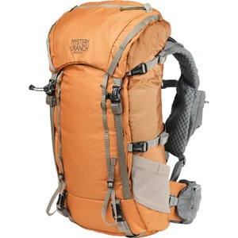
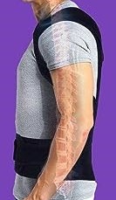
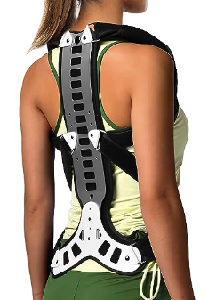
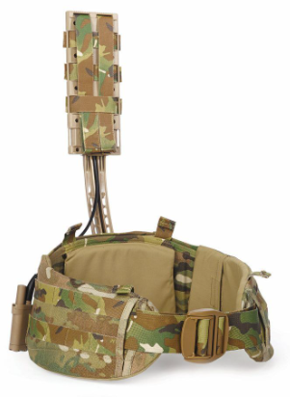
SpineAlign Prototype vs
Benchmarks
Mystery Rank Backpack Frame
Fitsupport Back Brace
Mazhonqi Posture Corrector
Quick Pack Release

Slide 29
Engineering Requirements vs Performance
Requirement | Target | Performance
Weight | 5 lbs | 4.6 lbs
Carrying Capacity | 25 lbs | Undetermined*
Price Range | 40-60 USD | 68.44 USD
Adjustable Shoulder Straps | 4 inches | 13.5 inches
Assembly Time | 30 minutes | 4.5 minutes
Requirement | Target | Performance
Time to Equip User | 60 seconds | < 60 seconds
Long-Lasting | > 5 years | < 50 uses
Handle Included | Yes | Yes
Rounded Edges | 100% rounded | 80% rounded
High Customer Rating | 8.0/10.0 | 6.93/10.0
Note: Green blocks indicate success. Yellow blocks indicate failure, but success is expected in mass-produced product (additive manufacturing limitations reduced performance). Red blocks indicate absolute failure in performance.
Best estimates based on medium-fidelity prototype.

Slide 30
Financial Analysis

Slide 31
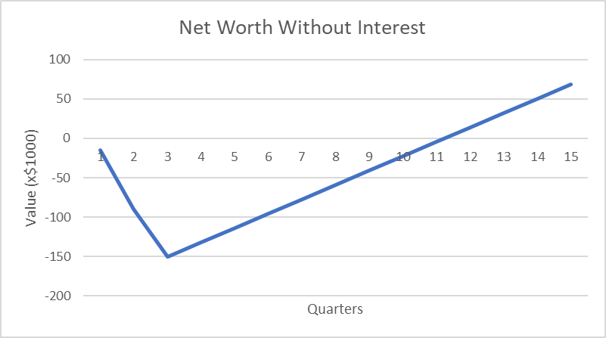
R+D Costs and Initial Investments
Tooling and Fixtures Cost: $120,000
  Paid over quarters 2 and 3, calculated by the estimated cost of fabricated parts and assembly costs to build moldings for ABS components
R+D cost: $30,000
  Paid over quarters 1 and 2, the team was quoted $30,000 for R+D by Deliverable 12
Production starts in quarter 4, plant profit of $18,165 per quarter
The figure above shows net cash flow through quarter 3 as negative before production begins

Slide 32
Investment Costs and Production
Estimated Cost: $17.11
  purchase cost: $3.11
  fabrication cost: $9.50
  assembly cost: $4.50 per part
Production volume: 7500 units per quarter, 30,000 annually
  Given to the team with Deliverable 12
Retail price: $68.44 per unit
Input
Interest Rate / year = | 8 | %
Analysis Periods / year = | 4 | #
Tooling and Fixtures = | 120.00 | (000)
Annual Production = | 30 | (000)
Estimated Purchased Parts = | 3.11 | $
Estimated Fabricated Parts = | 9.50 | $
Estimated Assembly Cost = | 4.50 | $
R&D Cost = | 30 | (000)
Cost, % of Retail = | 25 | %
Return to Project, % of Retail = | 30 | %

Slide 33
Profits and Break-Even Points
Net worth-
  Without interest: $67,980
  With interest: $37,690
The team expects to break even between quarter 11 and 12 (Q11.49), with the financial analysis showing a net worth of $13,480 in Q12
Return on Investment: 12.09%
Rate of Return: 0.68%
Team needs to make around 67,500 units to recuperate pre-production costs
Break-even point
Net worth after 15 quarters

Slide 34
Conclusion

Slide 35
Future Improvements
Mold several components as uniform bodies to increase strength
Revise shape of posture corrector to improve fit, comfort, and proper posture (consulting a physical therapist or ergonomics expert)
Include tension strap guide holes for shoulder straps
Include connection points for waist belt
Revise backpack support clip design to allow user to refine the position of load on the user's back (shift load up or down)

Slide 36
Next Steps
Survey results indicate that there is a viable, growing market
Existing products have demonstrated success
Design idea received ratings of 6 and above out of 10 during a design presentation to peers and industry professionals
The team has received positive feedback on current progress, and seeks to make design revisions previously mentioned, and gather testing data from users about product performance

Slide 37
References
[1] Backpack market size, share & covid-19 impact analysis, by product type (travel, hiking/camping, and others), by material (nylon, polyester, and others), by distribution channel (online channel and offline channel), and Regional Forecast, 2023-2030. Backpack Market Size, Growth, Share | Trends Analysis [2030]. (n.d.). https://www.fortunebusinessinsights.com/backpack-market-103853.
[2] Back Brace Posture Corrector for Women and Men Back Lumbar Support Shoulder Posture Support for Improve Posture Provide and Back Pain Relief. (n.d.). https://www.amazon.com/Posture-Corrector-Support-Shoulder-Improve/dp/B07NVBB8ZF?th=1.
[3] Backpack market size, share & covid-19 impact analysis, by product type (travel, hiking/camping, and others), by material (nylon, polyester, and others), by distribution channel (online channel and offline channel), and Regional Forecast, 2023-2030. Backpack Market Size, Growth, Share | Trends Analysis [2030]. (n.d.). https://www.fortunebusinessinsights.com/backpack-market-103853.
[4] Cheng, Te Chun. “Backpack with weight distribution features”, US 20 080 142 562 A1, December 05, 2007. https://patents.google.com/patent/US20080142562A1/en.
[5] Gleason, D. W. “Backpack Frame System”, US Patent 8 381 956 B2, February 26, 2013. https://patents.google.com/patent/US8561866B2/en?assignee=Mystery+Ranch+Ltd&oq=Mystery+Ranch+Ltd.
[6] Mazhonqi Posture Corrector Back Support for Hunched Back, Kyphosis and Vertebral Compression Fracture Men and Women. (n.d.). https://www.amazon.com/Mazhonqi-Posture-Corrector-Back-Support/dp/B0BDM1SR8P.
[7] Mystery ranch bridger 35L backpack. Backcountry. (n.d.). https://www.backcountry.com/mystery-ranch-bridger-35l-backpack.
[8] Protolabs. (2023, February 7). Injection Molding Tolerances. Protolabs. https://www.protolabs.com/resources/blog/injection-molding-tolerances/
[9] Robert, Jay. “Backpack system”, US Patent10 194 733 B2, August 16, 2013. https://patents.google.com/patent/US10194733B2/en?oq=10194733.
[10] Source DWD. Source Tactical Gear. (2020, July 28). https://www.sourcetacticalgear.net/about-us/dwd-dynamic-weight-distribution-system/.
[11] SyBridge Technologies. (2023, November 15). 4 best practices for optimizing injection molding tolerances. https://sybridge.com/injection-molding-tolerances-best-practices/#:~:text=Injection%20molds%20are%20typically%20CNC,001%20inches.
[12] Why walkable neighborhoods are hot when it comes to home sales. Purdue Exponent. (2023, August 4). https://www.purdueexponent.org/news/national/video_fbaf1743-344c-5ad6-a71b-b43691b6c773.html.
[13] Ye, Ronan. (2023, January 28). CNC Machining Tolerances. 3ERP. https://www.3erp.com/blog/cnc-machining-tolerances/

Slide 38
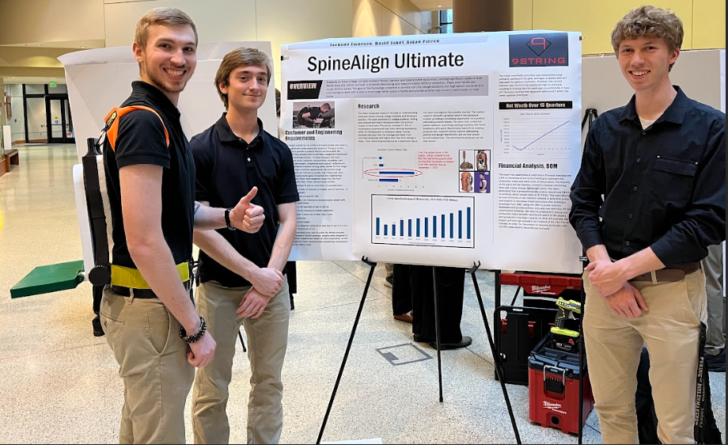
Questions?

